Slide 1
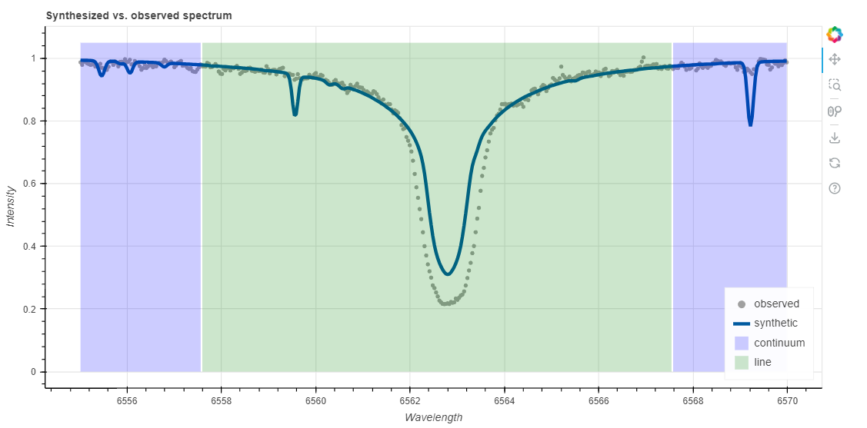
Lithium abundance in old stars
Data analysis with WebSME
Task 1 | The hydrogen line
Open the spectrum of the red giant ID7189 RGB_7189.fits in the analysis program http://websme.chetec-infra.eu/ Use the display of the spectrum to look at the individual absorption lines. Find the hydrogen alpha line (the strongest absorption line in the spectrum). Display it with a maximum wavelength range of 15 Å. Use this wavelength range for further analysis.
The following parameters were determined for the star: Temperature T_{eff} = 5100 K gravitational acceleration log(g) = 2.55 Radial velocity v_{rad} = 0 km/s Determine the remaining unknown stellar parameters for the wavelength range used using the online tool (initial guess).
Fig.: A fit of the hydrogen line with monh = -1.25
Note the value that the program has determined for the metallicity. Now set the value for the metallicity yourself and try out values between -4 and 0. (Leave v_{mic}, v_{mac} and v_{sini} undefined for this and the following tasks). How does the spectrum change with different values for the metallicity? Try it yourself and determine a value for the metallicity that is as accurate as possible. (Value at which the calculated spectrum best fits the measured data). Carry out an internet search on the term metallicity and then fill in the column Metallicity in the table "Stellar parameters".
Task 2 | The calcium lines
Now display the range 6160 - 6175 Å (calcium lines). Use the metallicity you have determined. Are you satisfied with the fit? If not, adjust your value for the metallicity.
Now change the values for vrad, Teff and log(g) to find out how they influence the spectrum. Fill in the columns in the "Stellar parameters" table (internet research if necessary)
Once you are satisfied with the spectrum, determine the calcium abundance for this area. Enter your values in the measurement table "Calcium measurement" on the online board.
Task 3 | Lithium abundance
Determine the stellar parameters and the lithium abundance for the stars assigned to you and then enter them in the "Lithium measurement" table. Please note:
Use only the lines 6707.76 Å and 6707.91 Å to determine the lithium abundance
Use the hydrogen line or other areas with strong lines to determine the parameters well before measuring the lithium. The lithium line is usually very weak. This means that the parameters must be well determined for an accurate measurement.
For the lithium line, work with a wavelength range of max. 3 Å is sufficient.
Materials created by Hannes Nitsche Creative Commons Attribution-ShareAlike 4.0 International (CC-BY-SA 4.0)

