Slide 1

Nuclear Astrophysics
A Journey through the Elements
This project has received funding from the European Union’s Horizon 2020 research and innovation programme under grant agreement No 101008324 (ChETEC-INFRA)

Slide 2
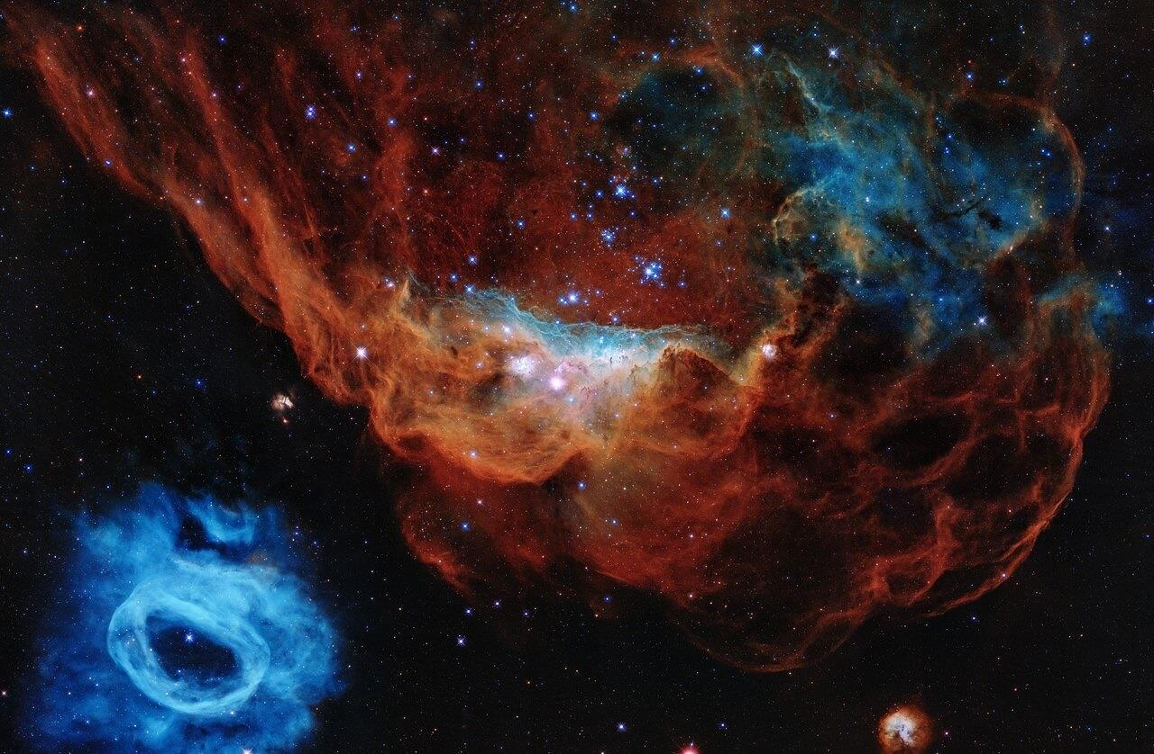
Nuclear Astrophysics
A Journey through the Elements

Slide 3
Time Schedule
Time | Content
30' | Part I Introduction
55' | Part II Atomic Nuclei & their Peculiarities
10' | Break
40' | Part III The Evolution of a Star
40' | Part IV On to Higher Elements!
30' | Lunch break
90' | Part V Stars in the Lab
10' | Break
30' | Part V Stars in the Lab- Continuation
15' | Conclusion
Notes:
Notes for Facilitators:
This schedule is only a suggestion
Please enter the times in the Time column and reschedule the breaks as needed.

Slide 4
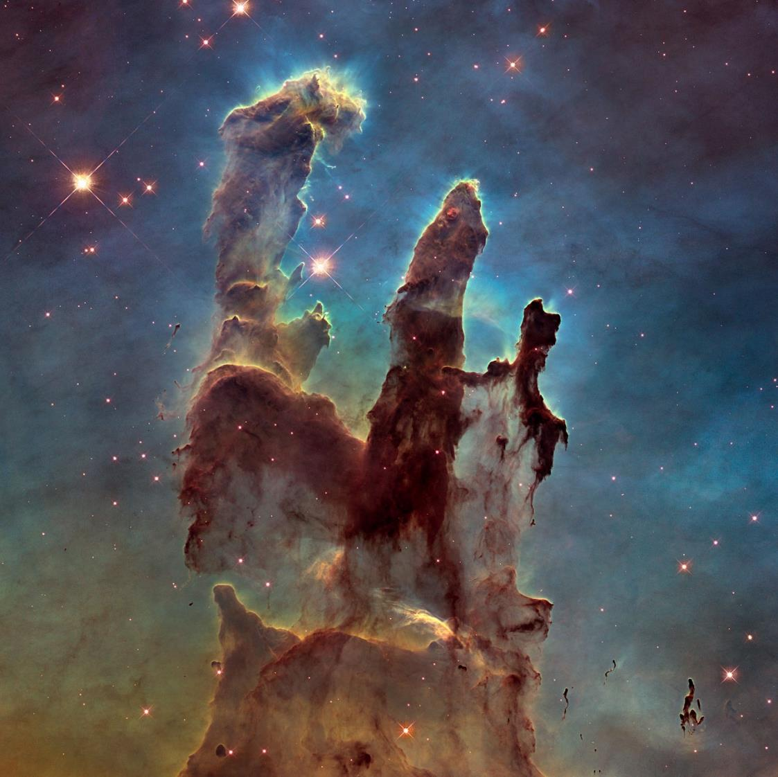
Part I
Introduction

Slide 5

Introduction round
Notes:
Notes for Facilitators:
If you work in the scientific field: Use the introduction round to give the participants an insight into your work and everyday life as a scientist.

Slide 6
What do you already know about
Nuclear Astrophysics?

Slide 7


Brainstorming
Task
Open the
$→$ 1.1 Brainstorming Board
and fill it out together.
Notes:
Notes for Facilitators:
The gear head icon indicates that the students have a task to do
The brainstorming board is used to collect students’ (mis-)conceptions of Nuclear Astrophysics before the input begins. At the end of the masterclass, these ideas are revisited and reviewed to see what has changed.

Slide 8
What is
Nuclear Astrophysics
actually ?
Notes:
Notes for Facilitators:
Grab the students' answers to this question on the Brainstorming Board here and discuss them before giving the definition.
The Question-Slides are used repeatedly to structure the Masterclass and give it a common thread. They aim to motivate and introduce the following Content

Slide 9
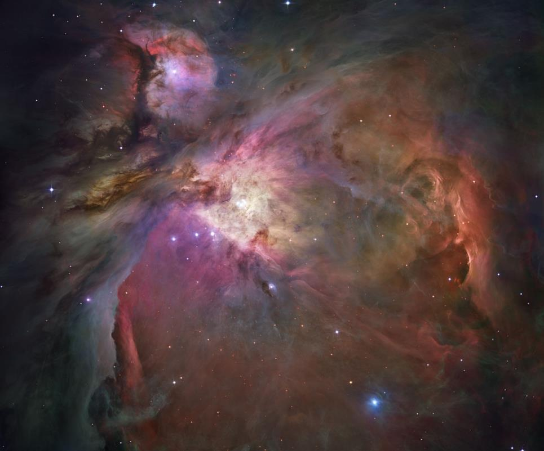
What is Nuclear Astrophysics?
Object of Observation
Nuclear Astrophysics studies the origin of chemical elements.
Nuclear Astrophysics takes a deep look into the universe to address this question.
[02] Orion Nebula, ESA/Hubble
Notes:
Notes for Facilitators:
A definition is used here that serves as the common thread of the Masterclass.
If desired, you can replace this definition with a more general & scientifically accurate definition.

Slide 10
What is a
Chemical Element ?
Notes:
Notes for Facilitators:
The following short lecture is used to discuss the evolution of the idea of chemical elements over the centuries and to derive the modern picture of a chemical element.
Nature-of-Science-Aspect:
In addition, you can use the metaphysical ideas to show what modern science is all about and discuss with the students why the approaches do not meet scientific quality criteria from today's point of view.

Slide 11
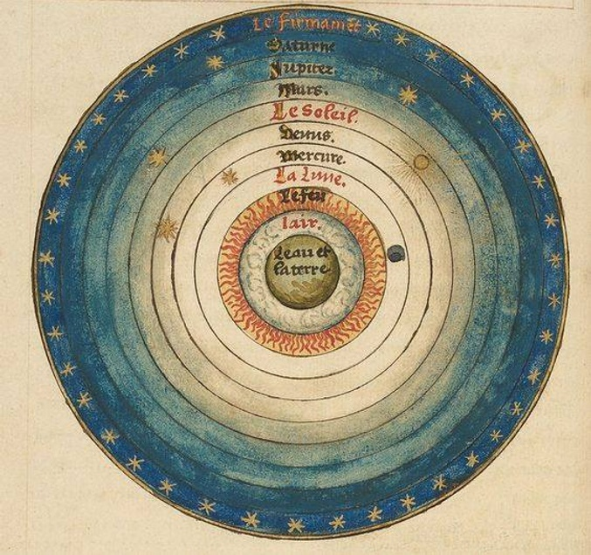
Elements in Antiquity (ca. 350 B.C.)
The Aristotelian Cosmos
Geocentric Idea of an Onion skin type cosmos
The four earthly elements form matter
All celestial bodies are moving naturally on its own
  Initial motion caused by an unmoved mover
“There must be an immortal, unchanging being, ultimately responsible for all wholeness and orderliness in the sensible world”
- Aristotle, Book 12 of Metaphysics
[03] Le Sphere du Monde, by Oronce Fine, 1549

Slide 12
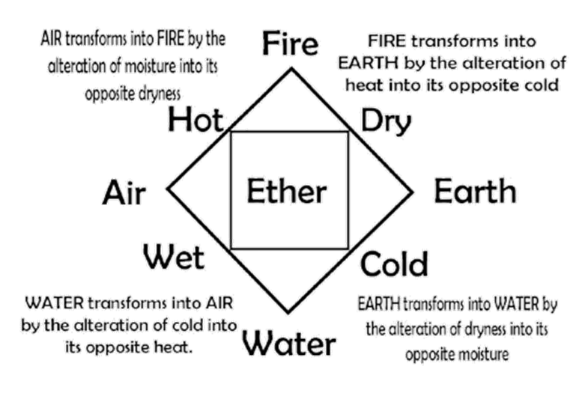
Elements in Antiquity (ca. 350 B.C.)
The Aristotelian Cosmos
The fifth element Ether fills the sky
  Quinta essentia, the exalted & perfect substance
Each substance is composed of the elements, composition determines the properties of the substance
Aristotle practiced Natural Philosophy
  No separation of physics / metaphysics
[04] The five Elements according to Aristotle
Notes:
Nature-of-Science-Aspect:
Aristotle never tested his theories experimentally
Aristotle designed natural philosophical ideas with the aim of creating holistic descriptions of the world.
Here you can give the additional Example, that he combined his concept of the four Elements with a concept of Gravitation:
According to him, an object that has a high mass must consist of a large proportion of earth.

Slide 13

Elements in Alchemy
Tria Prima (16th Century)
Paracelsus described
3 primary substances:
  Sulfur: The volatile and burning
  Mercury: The living and flowing
  Salt: The stable and solid
Transmutation
Idea of Transmutation: Chemical elements must be able to "come into being" somehow
one chemical element can be transformed into another
Philosopher's stone: Mystical substance that could be used to transform base metals into noble metals like gold
[05] The Three Primes

Slide 14
Elements in Alchemy
Tria Prima (16th Century)
Paracelsus described
3 primary substances:
  Sulfur: The volatile and burning
  Mercury: The living and flowing
  Salt: The stable and solid
Transmutation
Idea of Transmutation: Chemical elements must be able to "come into being" somehow
one chemical element can be transformed into another
Philosopher's stone: Mystical substance that could be used to transform base metals into noble metals like gold
My theory, proceeding as it does from the light of nature, can never, through its consistency, pass away or be changed.
Paracelsus, The Book Concerning the Tincture of the Philosophers
Notes:
Nature-of-Science-Aspect:
This Paracelsus quote is a great example for non scientific approaches. It completely contradicts the modern principles of scientific development (e.g. Karl Popper's principle of Falsification)

Slide 15
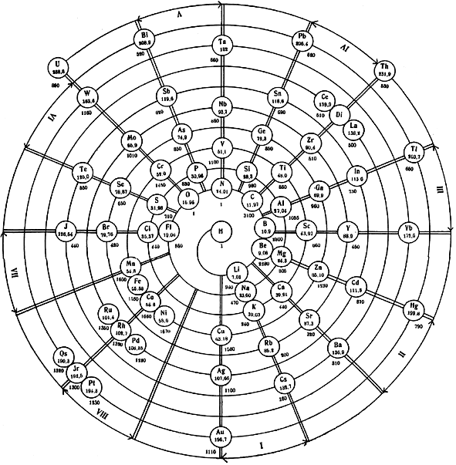
Evolution of the periodic table
17th Century: After scientific standstill in the Middle Ages: Step-by-step discovery of the basic elements via chemical measurement methods
Progressive development, despite lack of knowledge about the atom itself
1869: Design of the first periodic table: grouped and sorted by ascending atomic mass - Dmitri Mendelejew
1913: Investigation of spectral lines of atoms: confirmation of the order of the periodic table - Henry Moseley
[06] Outdated representation of the periodic table

Slide 16
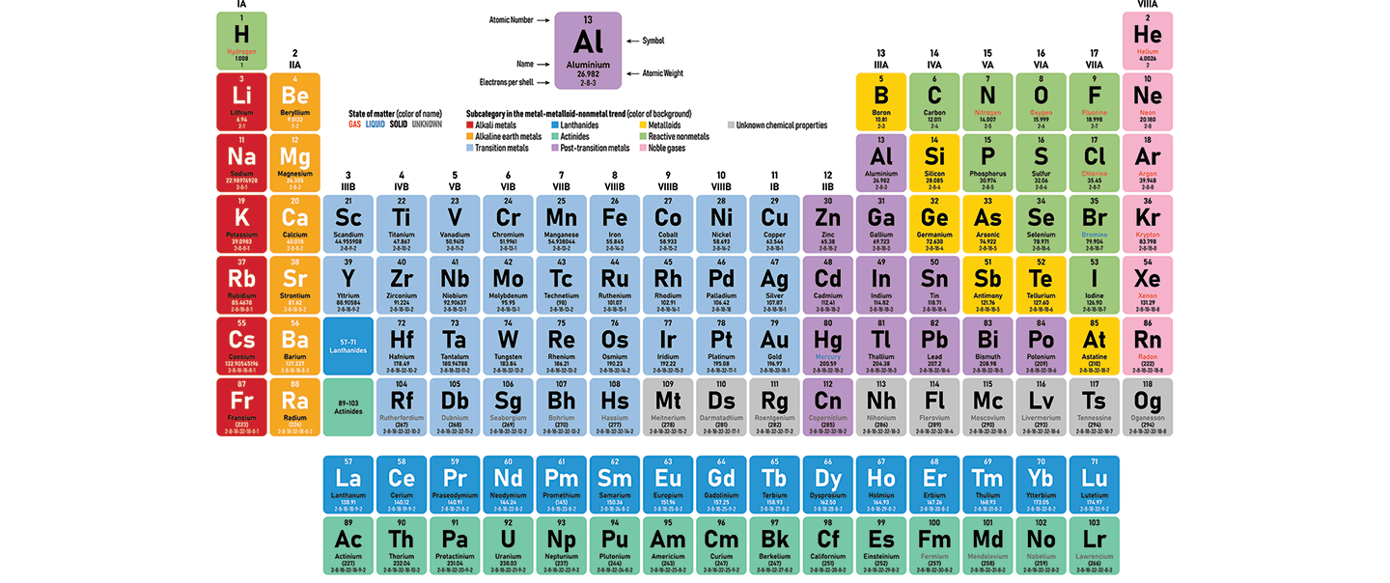
The Periodic Table of the Elements

Slide 17
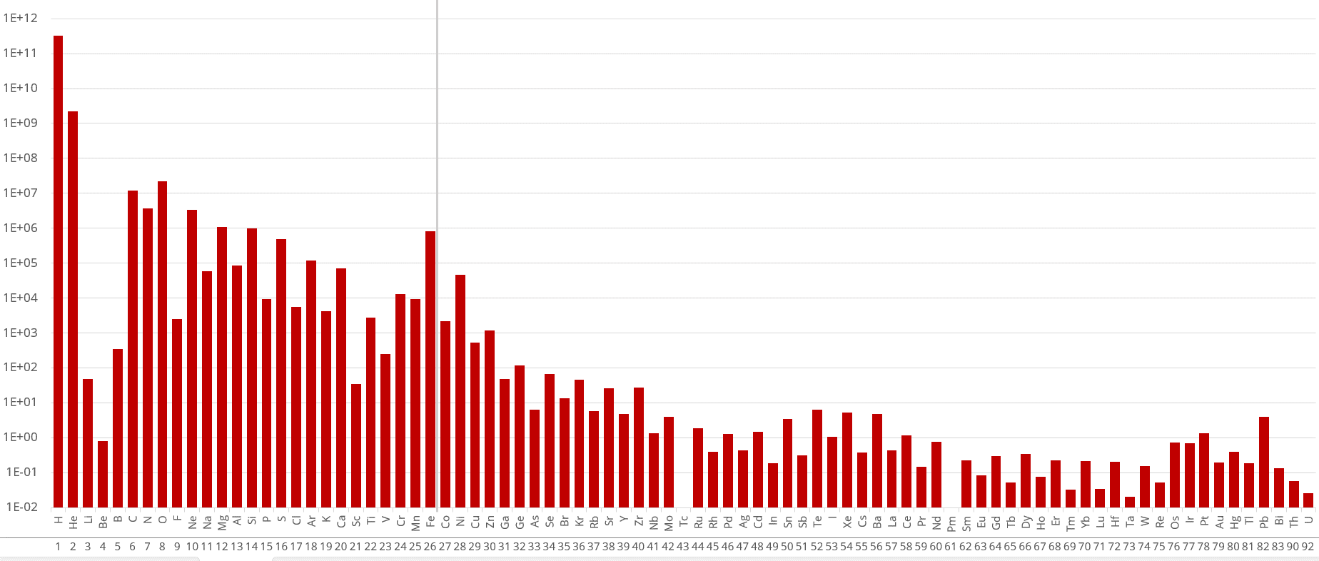
Abundance of the Chemical Elements (Solar System)
Relative abundance (logarithmic)
Atomic Number Z
Notes:
Notes for Facilitators:
Explain the logarithmic scale!
chemical abundances are one of the most important Observable of nuclear Astrophysics

Slide 18
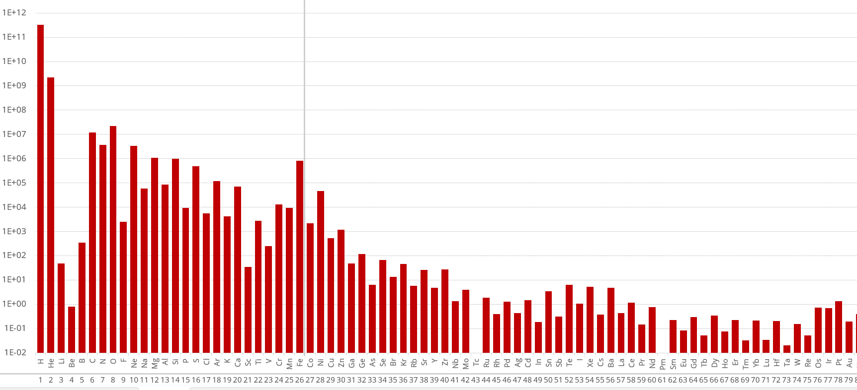
Abundance of the Chemical Elements (Solar System)
Task
Take a look at at the Abundance Distribution. What do you notice?
Notes:
Notes for Facilitators:
For this Task get back to the previous slide to show the bigger image
What the students should notice:
In general, the abundance becomes lower with increasing atomic number
There is a peak at Iron, marked with the grey line
A gap at Lithium & Beryllium
For some Elements, the abundance is Zero (You might throw the question into the room: “How do we know, that these Elements actually exist?”)
The abundance is higher for elements with even atomic number
You don’t have to explain the observations. But here you can tell them, that we will discover the reasons for this chemical abundance during the Masterclass

Slide 19
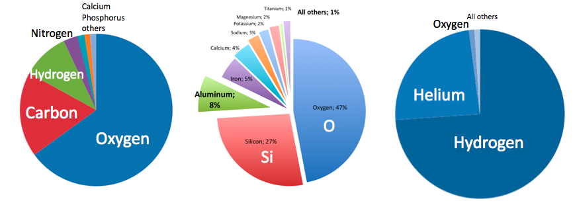
Abundance of the Chemical Elements
Human
Earth Crust
Universe
[07] Different Chemical Element Abundances

Slide 20

How can we explore the Origin of the Elements?
1.2 Felsenkeller Laboratory
Notes:
Notes for Facilitators:
We recommend downloading the video beforehand. Always be prepared for bad internet connection!
This video is just an uncommented short Camera Tour through an underground ion accelerator lab. If you want, you can already explain some of the equipment here, but this will be deepened later in the masterclass. The main purpose of the video is
to give students an insight into such a lab (without necessarily explaining anything)
to raise questions that will be answered later
Why is the lab underground?
What is the equipment for?
What does it have to do with observing processes in stars?

Slide 21
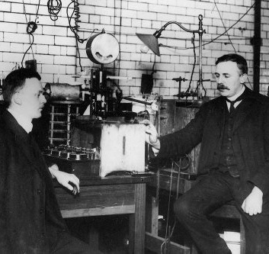
Part II
Atomic Nuclei &
their Peculiarities

Slide 22
What Defines a Chemical Element?

Slide 23
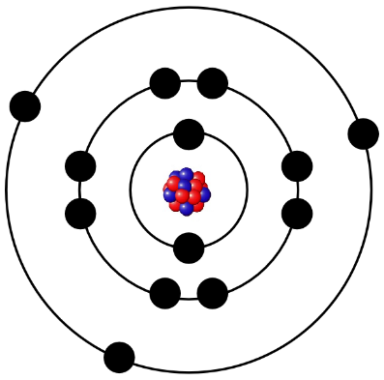
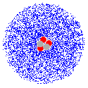
The Atomic Nucleus
An Element is characterized by the number of Protons in the atomic nucleus
Example:
Oxygen is the 8th element in the periodic table and has 8 Protons
Atomic nucleus
  in the center of the atom
  is 1/10000th of the size of the atom
  unites almost the entire mass in itself
Notes:
Notes for Facilitators:
For advanced students: Critically discuss Bohr's atomic model and take a brief look at quantum mechanical properties.
The (outdated) representation with the electron orbits is used here only to tie in with the image of atoms that many students have from chemistry classes. Feel free to delete it.

Slide 24
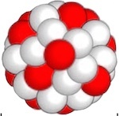
Atomic Nuclei labeling
Atomic nucleus consists of Protons and Neutrons
Example:
Oxygen has 8 protons and between 4 - 18 neutrons

Slide 25
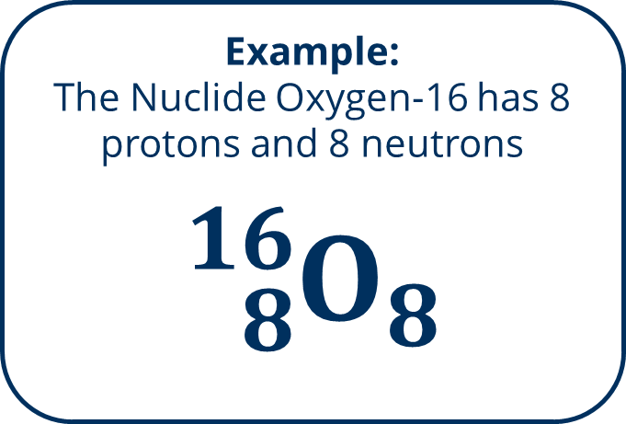
Atomic Nuclei labeling
One kind of atomic nucleus we call nuclide
  is determined by the number of protons and neutrons
Example:
The Nuclide Oxygen-16 has 8 protons and 8 neutrons
$${}_{8}^{16}{O_{8}}$$

Slide 26
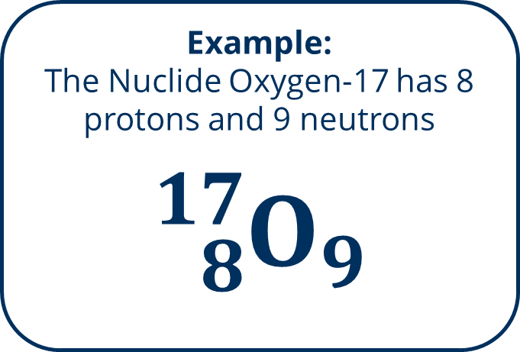
Atomic Nuclei labeling
One kind of atomic nucleus we call nuclide
  is determined by the number of protons and neutrons
Example:
The Nuclide Oxygen-17 has 8 protons and 9 neutrons
$${}_{8}^{17}{O_{9}}$$

Slide 27
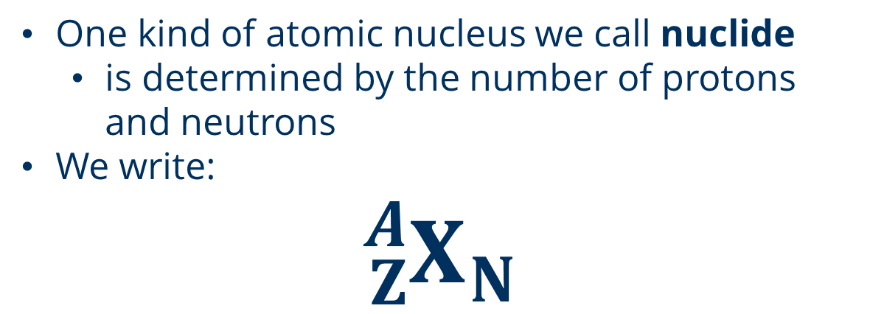
Atomic Nuclei labeling
One kind of atomic nucleus we call nuclide
  is determined by the number of protons and neutrons
We write:
$${}_{Z}^{A}{X_{N}}$$
X… Element Symbol
Z… Atomic Number / Proton Number
N… Neutron Number
A… Mass Number
A = Z + N
Notes:
Notes for Facilitators:
It is very important that the students have understood and can use the notation

Slide 28
Atomic Nuclei labeling
Task
How many Neutrons does
Uranium-238 have?
Mass Number A
Chemical Symbol
Proton Number Z

Slide 29
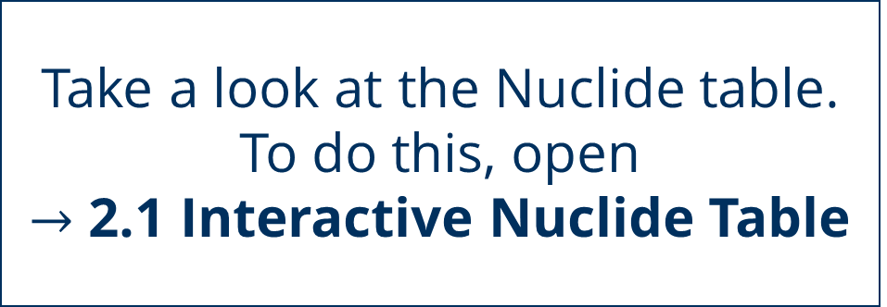
Atomic Nuclei labeling
Task
Take a look at the Nuclide table. To do this, open
$→$ 2.1 Interactive Nuclide Table
Notes:
Notes for Facilitators:
Give them a few minutes to explore the interactive nuclide table. Use it as a transition to the next task with the nuclear reactions.

Slide 30
How can Atomic Nuclei change?

Slide 31
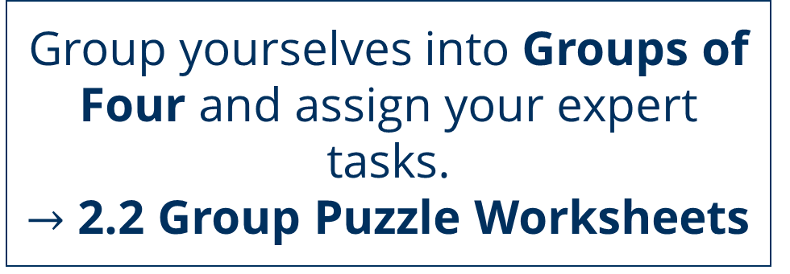
Nuclear Reactions
Task 1
Group yourselves into Groups of Four and assign your expert tasks.
$→$ 2.2 Group Puzzle Worksheets

Slide 32
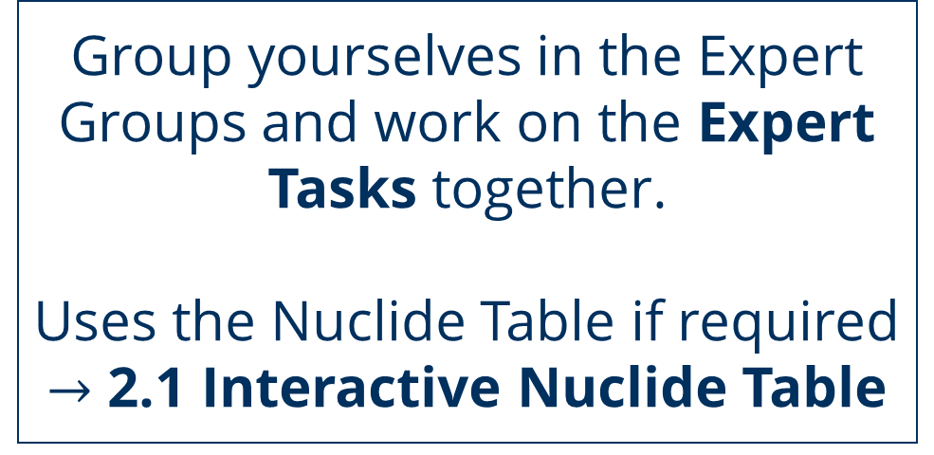
Nuclear Reactions
Task 2
Group yourselves in the Expert Groups and work on the Expert Tasks together.
Uses the Nuclide Table if required
$→$ 2.1 Interactive Nuclide Table
Notes:
Notes for Facilitators:
While students are working on the expert tasks, check that they have everything correct before sharing their results with the Home Groups

Slide 33
Nuclear Reactions
Task 3
Gather back in the original groups and work together on the Home Group Tasks.

Slide 34
Why do
nuclear Conversions
take place?

Slide 35
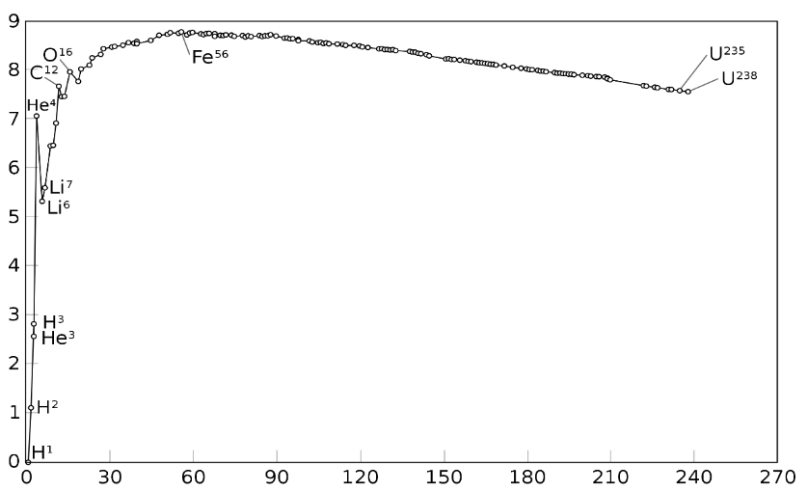
Binding Energy
Binding Energy is a measure for the stability of an atomic nucleus
  Stability depends on distribution of proton and neutron numbers as well as complex symmetry factors
Nuclei which can change into stable states by nuclear conversions are unstable (radioactive)
Nuclei can also reach a more stable state by nuclear fusions
Binding Energy per Nucleon (MeV)
Mass Number A
Notes:
Notes for Facilitators:
Here we try to break all the nuclear processes down to explain them just with the concept of Binding Energy. Even though this is a great simplification, it helps to focus the content.
Explain to them that atomic nuclei "want" to go to a more stable state and that nuclear processes are used to reach this state.

Slide 36
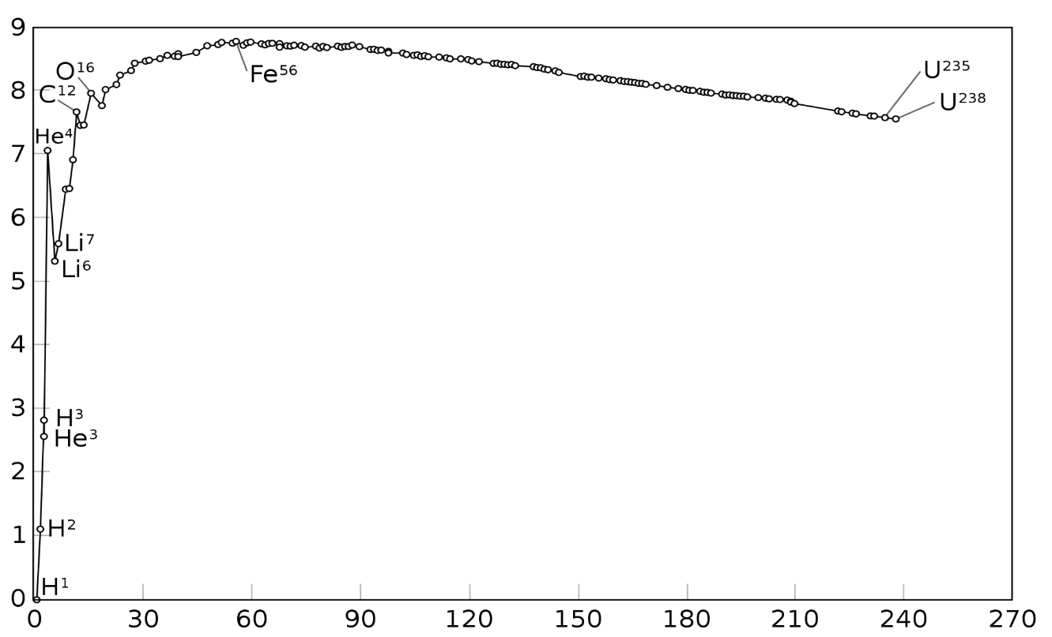
Binding Energy
Binding Energy per Nucleon (MeV)
Mass Number A
Notes:
Notes for Facilitators:
After the Stellar Evolution Part the Concept of Binding Energy will be used to explain the chemical abundances. But at this point you might already explain the Iron Peak and Lithium Gap.

Slide 37
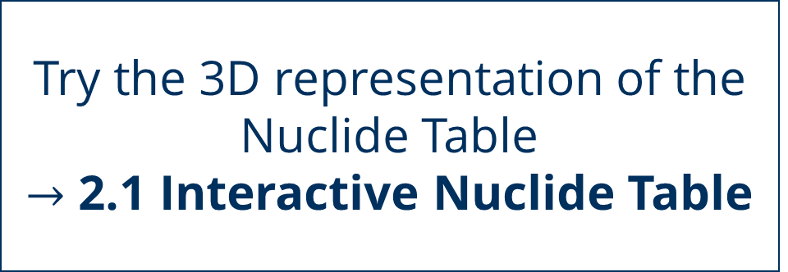
The Nuclide Table
Task
Try the 3D representation of the Nuclide Table
$→$ 2.1 Interactive Nuclide Table
Notes:
Notes for Facilitators:
You can access the 3D view with the icon on the top right with the four bars. You can pan and turn the view, to take a look at the valley of stability.
I you want to simplify it, use the “Skateboard in a Halfpipe” Analogy. The Skateboard wants to go to the “lowest state” at the middle of the pipe and does not go up except when excited. In general, the further out from the valley the nuclide is, the more unstable it is. The same goes for the Skateboard, which is faster if it starts at the top of the Halfpipe.

Slide 38
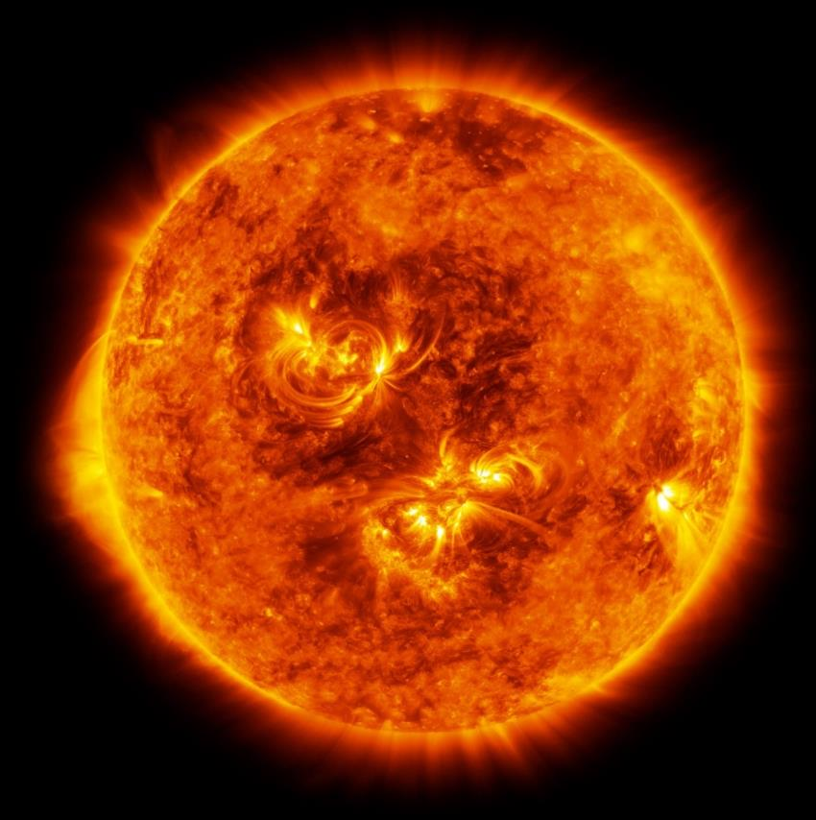
Nuclear Reactions
Through Nuclear fusion or conversion (decays) new atomic nuclei can be created.
These processes are the basis for the formation of new elements!
[09] Illustration of the Red Supergiant Antares

Slide 39
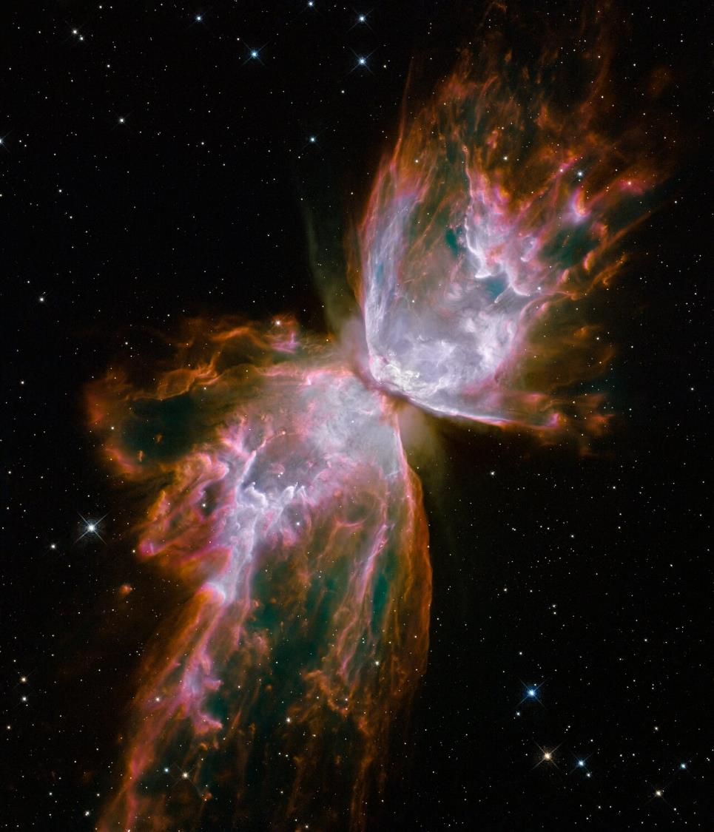
Part III
The Evolution of
a Star

Slide 40
Where are
elements created?

Slide 41
Stellar Evolution
Task
Pick stars from the
→ 3.1 Star Profile Cards
and arrange them in the shared diagram.
To do this, open the
→ 3.2 HRD Board

Slide 42
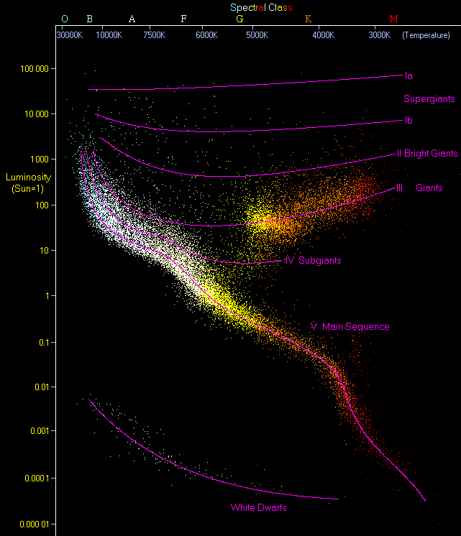
Notes:
Notes for Facilitators:
Use this illustration of the Hertzsprung-Russell-Diagram for the motivation of the following lecture. Where is this structure coming from? Why are the stars not evenly distributed?

Slide 43
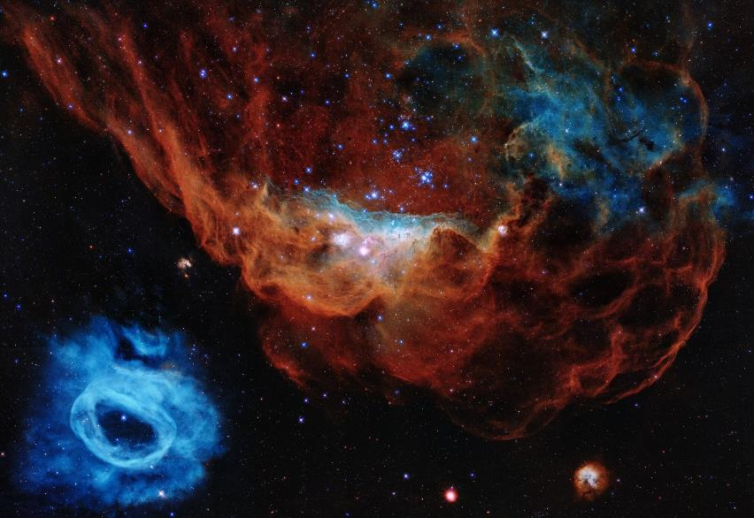
Stellar Evolution
About 5 stars are formed in our Milky Way every year.
Formation takes approx. 1 Million - 100 Million years
Originally through the contraction of molecular clouds of hydrogen (gravitation).
[12] The two nebulae NGC 2014 and NGC 2020, which are part of a star-forming region in the Large Magellanic Cloud, a galaxy in the Milky Way 163 000 light years away.
Hubble/ESA, 2020
Notes:
Notes for Facilitators:
On the following slides multiple images are used to show different astronomical objects. You can take a look at the linked sources an implement additional informations if you want.

Slide 44
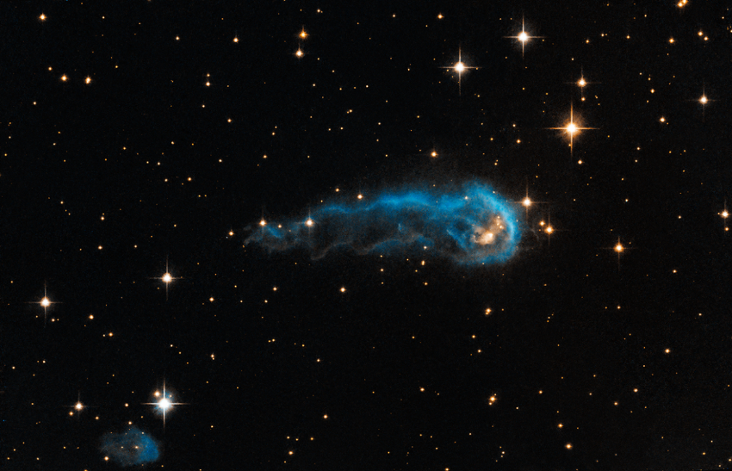
Stellar Evolution
Contraction creates a core with a higher density (gravitational collapse).
If the mass is high enough, the cloud collapses and thermal energy is emitted
If the density of the star is high enough, the radiation can no longer escape from the envelope, so the star heats up further
[13]The head of the so-called "Cosmic Caterpillar" gas cloud is a protostar that is still absorbing material from its outer envelope and slowly condensing.
Hubble/ESA, 2013

Slide 45
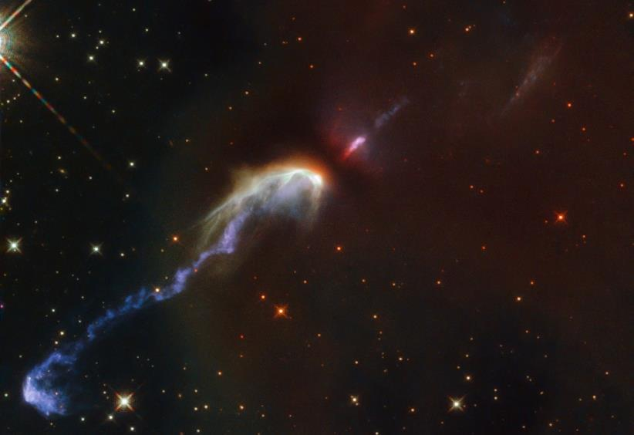
Stellar Evolution
A Protostar is formed
Gravitational force increases
Outer molecules crash into core
Several thousand Kelvin, light mostly in infrared range
Temperature is increased until the gas inside is ionised, gas becomes plasma
[14] Gas ejected from the protostar hitting dust clouds. Two jets are visible, moving diametrically away from the protostar at the centre.
Hubble/ESA, 2021
Notes:
Notes for Facilitators:
Reduce the explanation of thermodynamic processes to the interplay of the basic known physical quantities (mass, density, temperature).

Slide 46
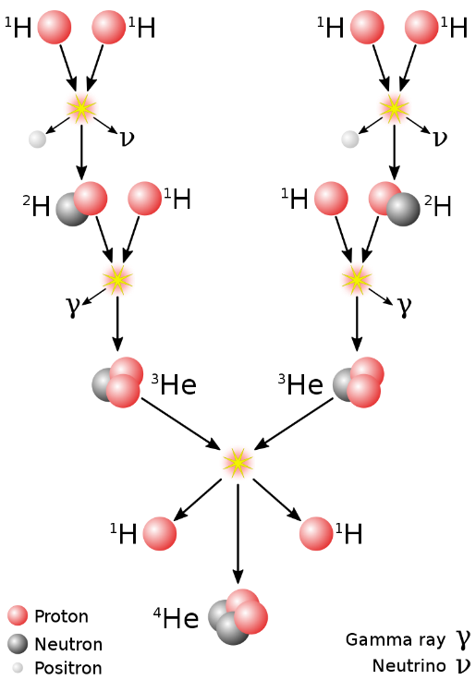
Stellar Evolution
Temperature and Density are high enough for the atomic nuclei to overcome the Coulomb barrier
Fusion of Hydrogen: Helium is formed and accumulates inside the core
Radiation & Gas Pressure as opposing force to gravity
Star has reached a stable state!
Hydrostatical Equilibrium: Gravity and Pressure balanced
Notes:
Notes for Facilitators:
Treat the shown reaction chain only in general terms. The students don’t need to memorise it
Explain the stable state of a star: Gravitational force = Radiation pressure
=> Star needs fusion processes for stable state!

Slide 47
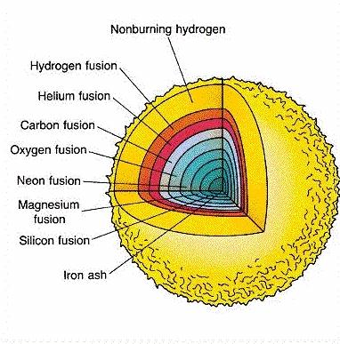
Stellar Evolution
The higher the element, the higher the Coulomb Barrier
If Temperature & Density are high enough, helium fusion becomes possible
Depending on the mass of the star, further elements can fuse
Star goes through Life Phases that are coupled to the nuclear fusion processes

Slide 48
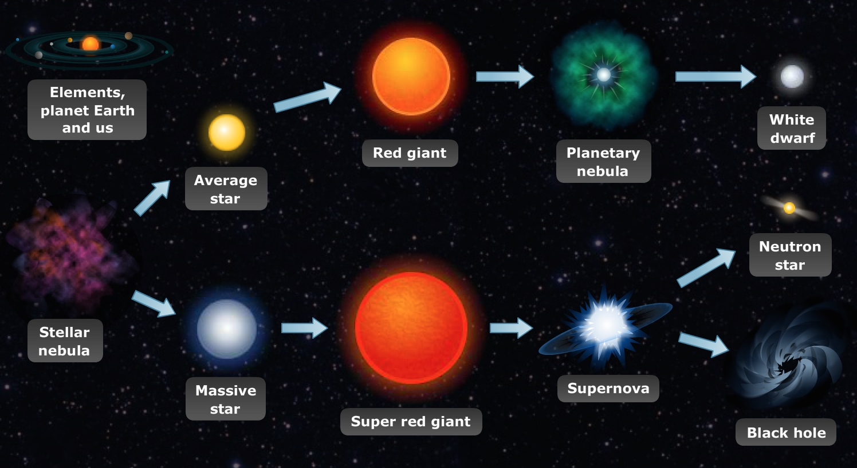
Stellar Evolution
[15] Life Phases of Stars

Slide 49

Stellar Evolution
[10] The planetary nebula NGC 6302, also called the Butterfly Nebula, lies in our Milky Way, about 3800 Lj away. In the centre is a dying star that had five times the mass of the sun. It has ejected its gas shell and is now releasing a stream of UV radiation that makes the ejected matter visible.
Hubble/ESA, 2009
Notes:
Notes for Facilitators:
Those objects are used as examples to give the students an insight in the different phenomena of stellar evolution

Slide 50
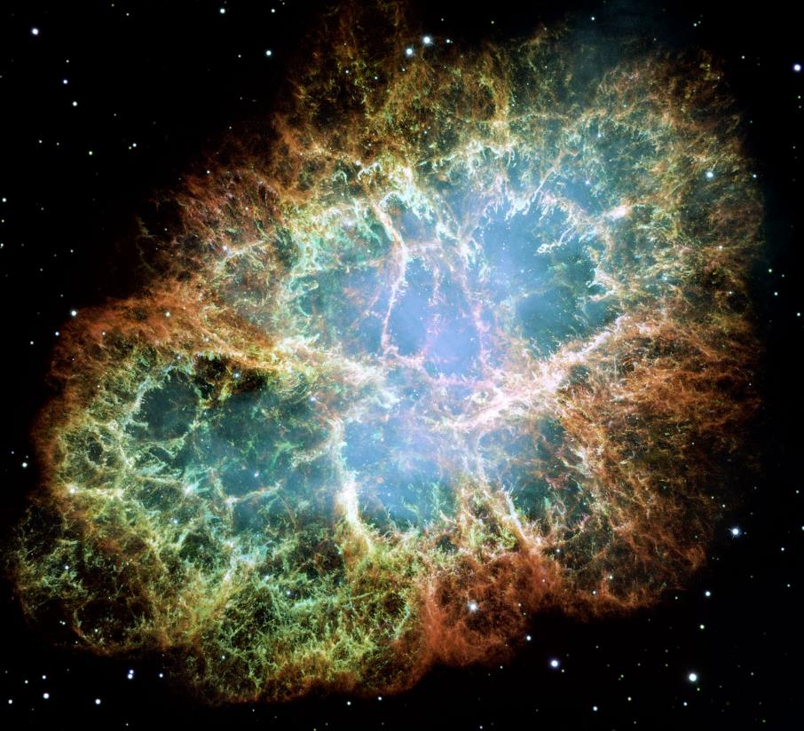
Stellar Evolution
[16] The Crab Nebula, located 6500 light years away in the constellation Taurus, is the result of a supernova explosion observed by astronomers in 1054. At its centre is an extremely dense neutron star that spins once every 33 milliseconds, emitting rotating lighthouse-like beams of radio waves and visible light.
Hubble/ESA, 2017

Slide 51
Notes:
Notes for Facilitators:
The principle of stability can be used to explain why only certain areas in the HRD are “occupied” by stars

Slide 52
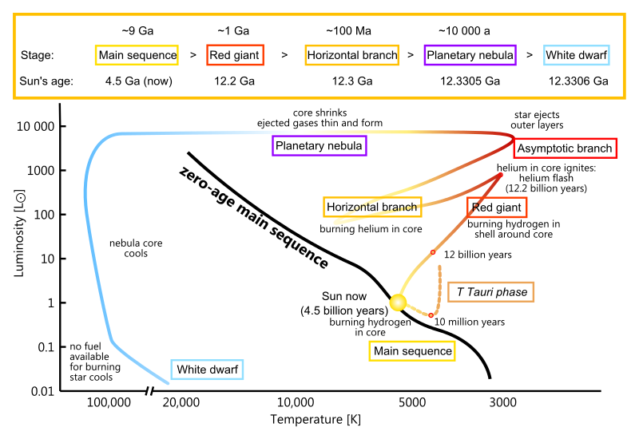
The Story of our Sun
Sun is born 4,5 Billion years ago
Sun stabilizes in Main Sequence
Hydrogen fusion leads to Helium core and Hydrogen-shell
[17] HRD

Slide 53
The Story of our Sun
Hydrogen in core consumed, core contracts, becomes hotter
Sun expands, becomes brighter but cooler on the outside
Sun becomes a Red Giant with a Hydrogen shell and Helium core

Slide 54
The Story of our Sun
Helium ignites abruptly in the core
  Helium Flash
Temperature inside rises, Sun gets hotter
Helium burns in the core:
Triple-Alpha process

Slide 55
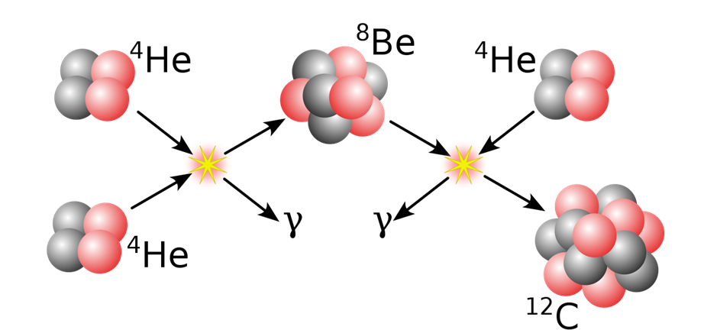
The Story of our Sun
Helium ignites abruptly in the core
  Helium Flash
Temperature inside rises, Sun gets hotter
Helium burns in the core:
Triple-Alpha process

Slide 56
The Story of our Sun
Helium consumed in core
Sun now has Hydrogen shell, Helium shell and Carbon/Oxygen core
Sun expands, becomes brighter but cooler on the outside

Slide 57
The Story of our Sun
Sun loses mass with each thermal pulse until the core is exposed
Ejected shell forms a planetary nebula
Exposed Core forms White Dwarf
  cools down quickly, no more reactions possible
  Consists mostly of Carbon and Oxygen
  approx. the mass of the Sun & the size of the Earth

Slide 58
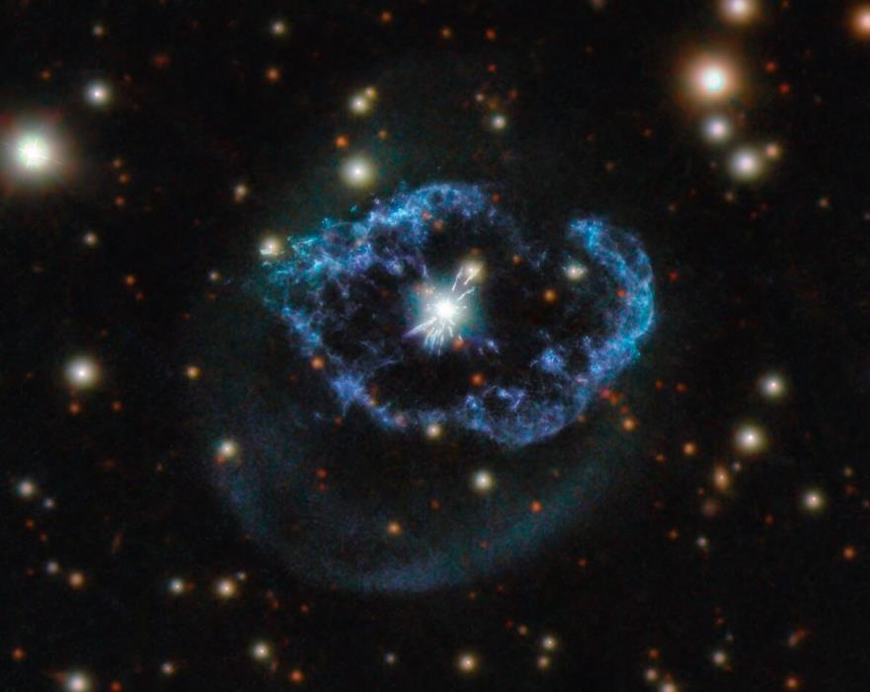
The Story of our Sun
Sun loses mass with each thermal pulse until the core is exposed
Ejected shell forms a planetary nebula
Exposed Core forms White Dwarf
  cools down quickly, no more reactions possible
  Consists mostly of Carbon and Oxygen
  approx. the mass of the Sun & the size of the Earth
[18] A Planetary Nebula in Cygnus
Hubble/ESA, 2021

Slide 59
Abundance of the Chemical Elements (Solar System)

Slide 60
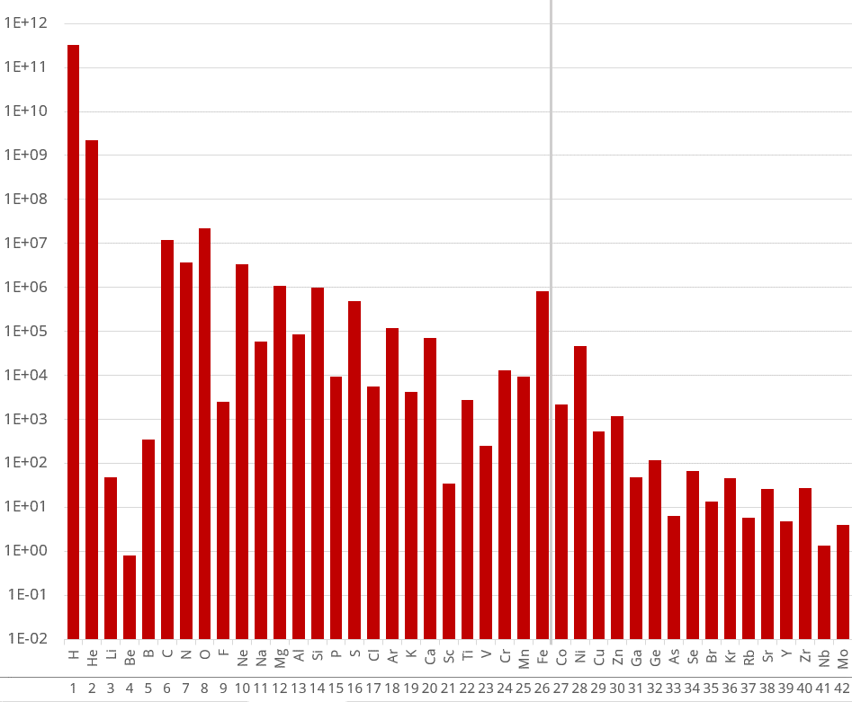
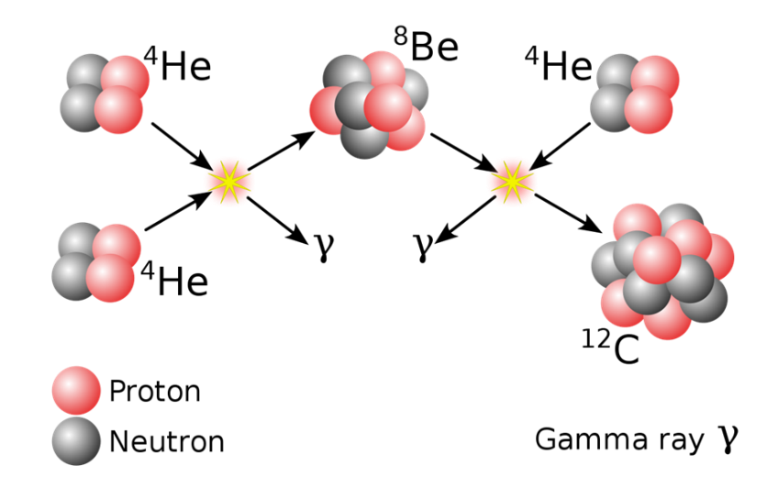
Abundance of the Chemical Elements (Solar System)
Notes:
Notes for Facilitators:
Now we can use our understanding of the processes in stars to explain the element abundances. The Lithium Gap can be explained with the 3a-Process that skips Li & Be. Be8 is just an unstable intermediate state (due to the higher Binding Energy of Helium)

Slide 61
Abundance of the Chemical Elements (Solar System)
Elements up to Iron can be synthesized by nuclear fusion in stellar processes
As a result, there is an increased iron abundance
Notes:
Notes for Facilitators:
The term “stellar processes” is very general here
Of course, most of the chemical elements here are not formed in simple fusions in stable stars as shown so far but in exploding massive stars, exploding white dwarfs etc.
Decide how much detail you want to go into here based on the students' proficiency levels

Slide 62
Binding Energy
Binding Energy per Nucleon (MeV)
Mass Number A
Notes:
Notes for Facilitators:
Emphasize the link between binding energy and element abundance

Slide 63
Binding Energy
???
Nuclear Fusion
Binding Energy per Nucleon (MeV)
Mass Number A
Notes:
Notes for Facilitators:
Use this as a introduction of the next chapter

Slide 64
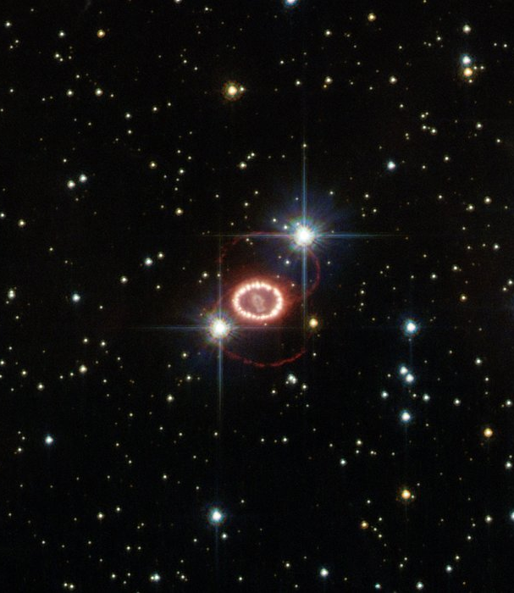
Part IV
On to
Higher Elements!

Slide 65
How can heavier elements be synthesized?
Notes:
Notes for Facilitators:
Give the students time to think about this question.
If they can remember the Coulomb barrier and the various nuclear reactions from the group puzzle, it should occur to them themselves that neutron capture might be an important process for this.

Slide 66
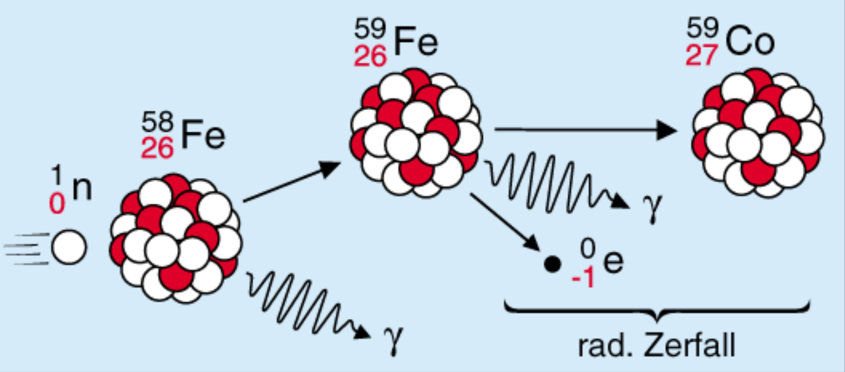
Neutron Capture
Radioactive Conversion
Notes:
Notes for Facilitators:
Treat the Neutron Capture as a special kind of nuclear fusion. Basically, it’s a nuclear fusion that doesn't have to deal with the Coulomb barrier.
Given what students know so far, the question might arise, "Why would such a process occur if Fe-58 is already stable?”
The simplest answer based only on the concepts discussed so far (even if it is not the most accurate) would be:
“The free neutron itself is unstable and a fusion with the Fe-58 provides an overall more stable physical system”

Slide 67
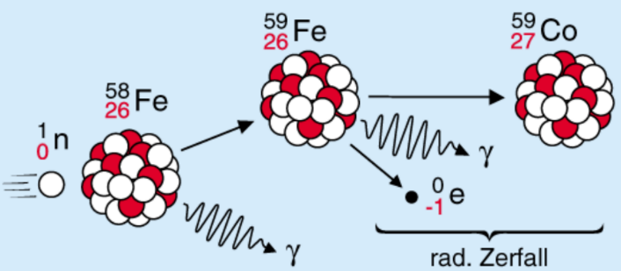

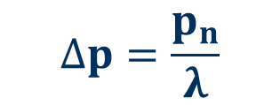
Neutron Capture
The Iron-59 can undergo another neutron capture reaction before it decays
The probability ratio of whether the nuclide decays or a chain of neutron capture reactions is triggered instead depends on the neutron flux
Radioactive Conversion
$$∆p=\frac{p_{n}}{λ}$$
$$p_{n}…Neutron Capture Rate \\ λ …Decay Rate$$

Slide 68
The Nuclide Race Board Game
Task
Use the Nuclide Table as a Game Board to explore Neutron Capture Processes.
→ 4.1 Game Rules
→ 4.2 Game Board

Slide 69
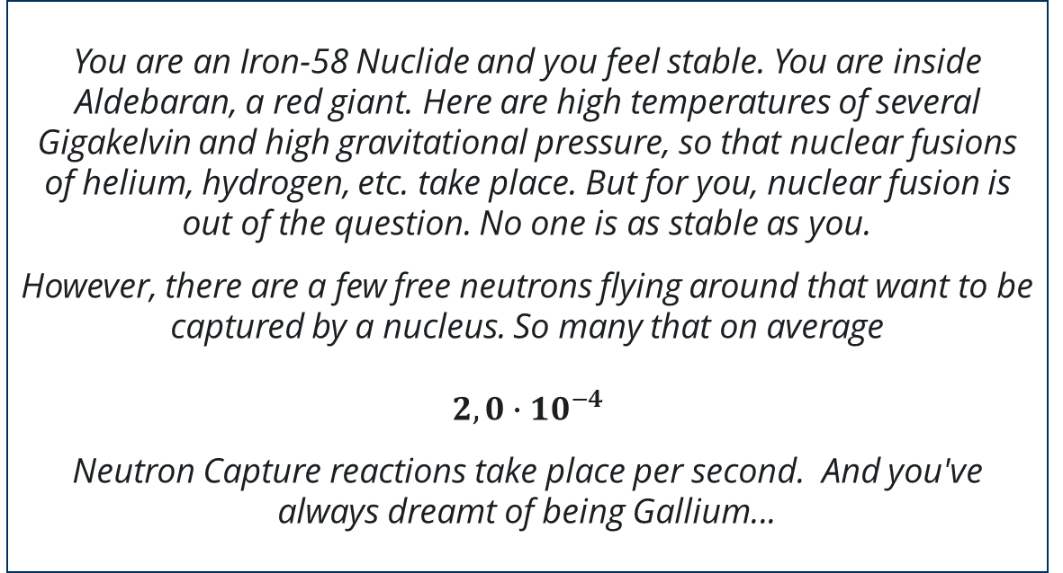
The Nuclide Race Board Game
Scenario 1
You are an Iron-58 Nuclide and you feel stable. You are inside Aldebaran, a red giant. Here are high temperatures of several Gigakelvin and high gravitational pressure, so that nuclear fusions of helium, hydrogen, etc. take place. But for you, nuclear fusion is out of the question. No one is as stable as you.
However, there are a few free neutrons flying around that want to be captured by a nucleus. So many that on average
$$2,0∙{10}^{−4}$$
Neutron Capture reactions take place per second. And you've always dreamt of being Gallium...
Notes:
Notes for Facilitators:
Of course, it is an extreme simplification to assume that the neutron capture rate is the same for each nuclide (it even varies extremely).
You can optionally show the picture on slide 72 after the board game and explain the approximation.
Again, decide how much detail you want to go into here based on the students' proficiency levels

Slide 70
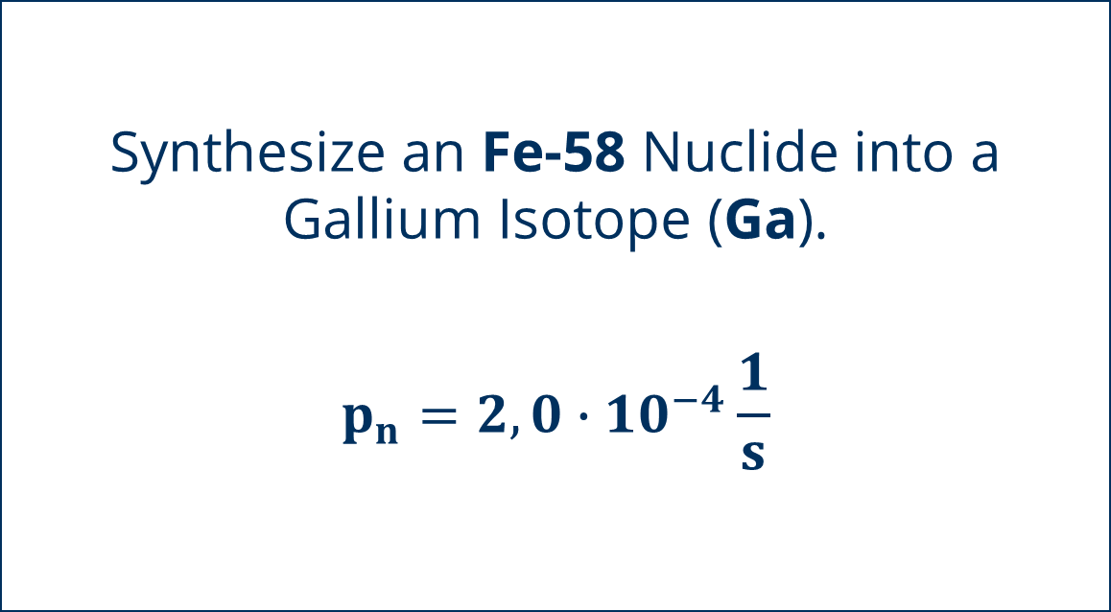
The Nuclide Race Board Game
Scenario 1
Synthesize an Fe-58 Nuclide into a
Gallium Isotope (Ga).
$$p_{n}=2,0∙{10}^{−4}\frac{1}{s}$$
Notes:
Notes for Facilitators:
The rules of the game may be a little more difficult for students to understand than one might think.
For the beginning it is good to do the first steps together with the students so that everyone understands the principle.

Slide 71
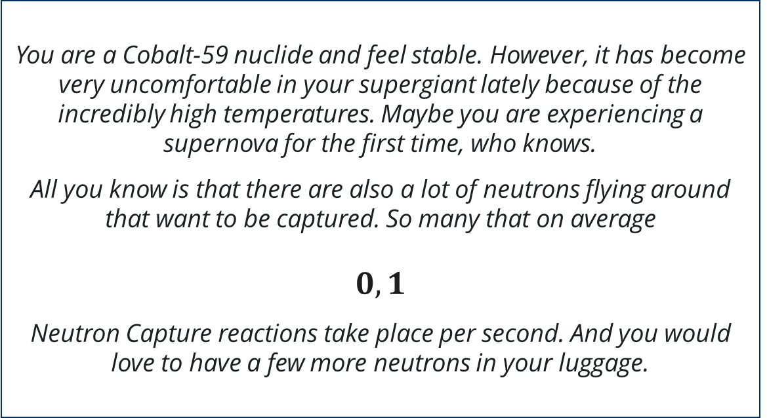
The Nuclide Race Board Game
Scenario 2
You are a Cobalt-59 nuclide and feel stable. However, it has become very uncomfortable in your supergiant lately because of the incredibly high temperatures. Maybe you are experiencing a supernova for the first time, who knows.
All you know is that there are also a lot of neutrons flying around that want to be captured. So many that on average
$$0,1$$
Neutron Capture reactions take place per second. And you would love to have a few more neutrons in your luggage.
Notes:
Notes for Facilitators:
Of course, it is an extreme simplification to assume that the neutron capture rate is the same for each nuclide (it even varies extremely).
You can optionally show the picture on slide 72 after the board game and explain the approximation.
Again, decide how much detail you want to go into here based on the students' proficiency levels

Slide 72
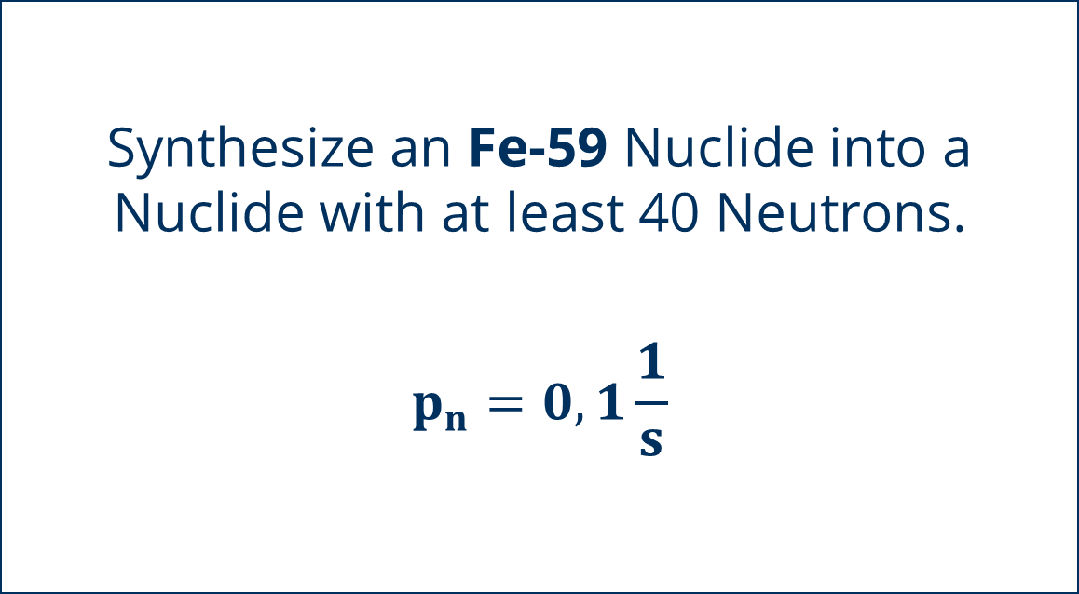
The Nuclide Race Board Game
Scenario 2
Synthesize an Fe-59 Nuclide into a Nuclide with at least 40 Neutrons.
$$p_{n}=0,1\frac{1}{s}$$

Slide 73
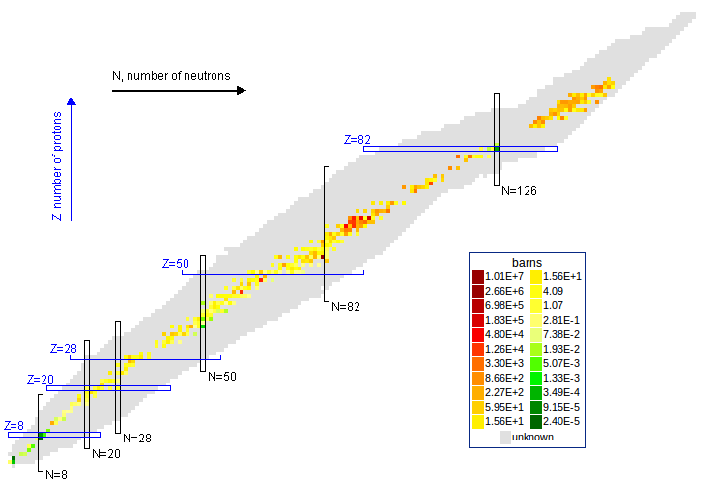
[20] Thermal Neutron Capture Cross Section
Notes:
Notes for Facilitators:
This page is optional and can be deleted if desired. It is used to explain the approximation of the game. It actually shows the Thermal Neutron Capture Cross Section.
It is not mandatory to explain the Barn unit here. It is more important that the students understand that the reaction probability resp. rate is not the same for all nuclides and varies very strongly (note exponents from -5 to +7).

Slide 74
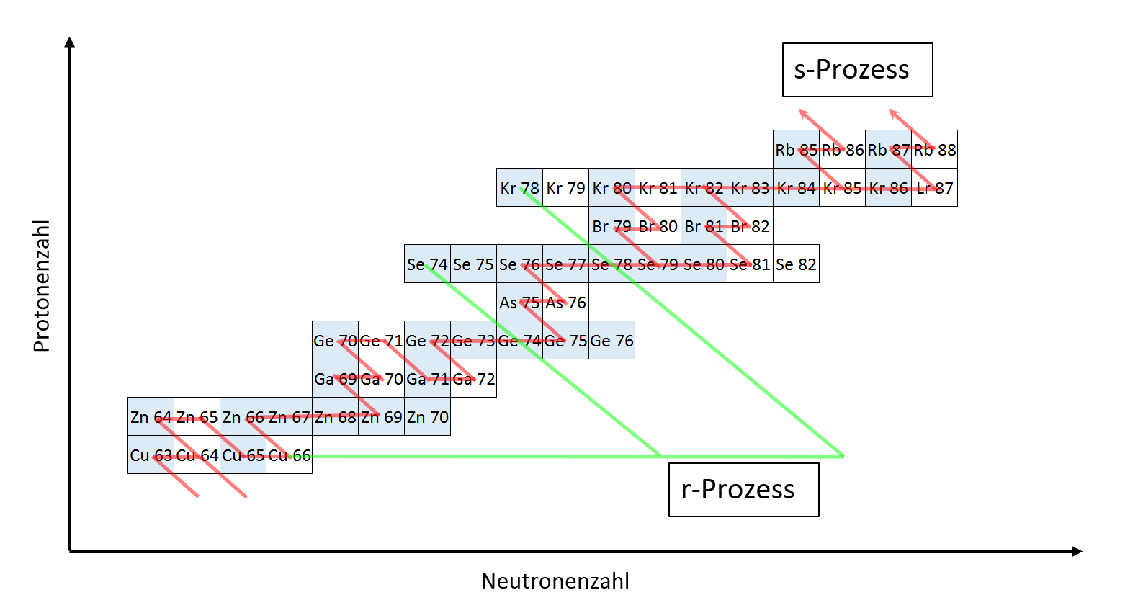
S- and R-Processes
s-Process
s-Process (slow)
  At relatively low temperatures and neutron flux densities.
  Mainly in AGB stars during shell burning
  Slow reaction chain via several stable intermediate nuclides
Proton Number
r-Process
Neutron Number
r-Process (rapid)
  At very high neutron flux densities and temperatures
  Fast chain of capture reactions
  Presumably in supernovae and neutron star mergers
Notes:
Notes for Facilitators:
Emphasize the difference between these two processes by referring to the scenarios of the game (Scenario 1 -> s-Process, Scenario 2 -> r-Process)
To be precise, scenario 2 is more of an intermediate process - real r-processes would be very boring in the game ;) - but the principle still becomes clear

Slide 75
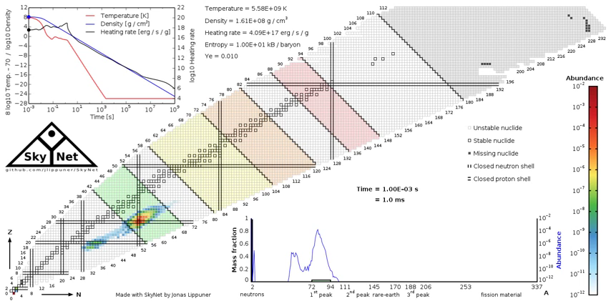
R-Process in Action
Notes:
Notes for Facilitators:
Use this Animation to repeat the r-process and emphasize the complex branching of the reaction chain
repeat the Animation if needed
There are a lot of informations in this animation. Get the students to focus on the important ones
The Nuclide Chart with element abundance as color code.
The time displayed under the chart
The temperature curve (red curve top left)
Above the Nuclide Chart you can see the assumed initial values – The Temperature is important here so that the students get an impression of the scale

Slide 76
Where do the neutrons
come from ?

Slide 77
Neutron Sources
There is a wide variety of reaction chains in which by-products are produced e.g. Neutrinos & Photons in Hydrogen-Burning
Are there fusion chains in which free neutrons are produced?
The Search for Neutron Sources

Slide 78
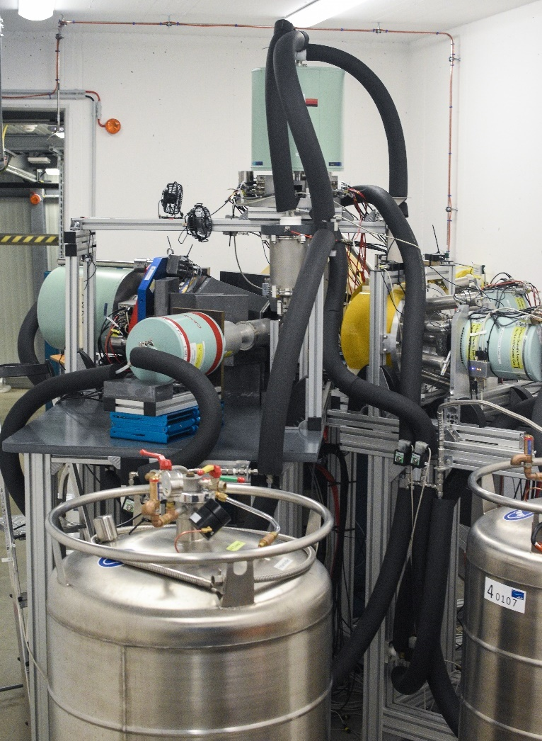
Part V
Stars in the Lab

Slide 79
How can we measure the nuclear Processes inside Stars?
Astronuclear Nibble
Notes:
Notes for Facilitators:
We recommend downloading the video beforehand. Always be prepared for bad internet connection!

Slide 80

Nuclear Reaction Measurements
[22] Schematic Layout of a nuclear physics experiment
Notes:
Notes for Facilitators:
On this and the next slide you can repeat some of the contents of the video.
Decide how much technical detail you want to go into here based on the students' proficiency levels

Slide 81




Nuclear Reaction Measurements
Pelletron-Accellerator in the Felsenkeller Laboratory
Solid Nitrogen Target
Multiple Detectors surrounding the Target
Notes:
Notes for Facilitators:
On this slide you can repeat some of the contents of the video.
Decide how much technical detail you want to go into here based on the students' proficiency levels

Slide 82


Goal of the Measurment
Reaction to be examined:
$${}_{7}^{14}{N+{}_{2}^{4}{He→{}_{9}^{18}{F+γ}}} \\ {}_{9}^{18}{F+e^{−}}→{}_{8}^{18}{O+ν_{e}} \\ {}_{8}^{18}{O+{}_{2}^{4}{He→{}_{10}^{22}{Ne}}} \\ {}_{10}^{22}{Ne}+{}_{2}^{4}{He}→{}_{12}^{25}{Mg+n}$$
One of the many Reaction Chains that might be an important Neutron Source
In particular, for each reaction we need to know how many nuclear fusion events happen every second in a star of a given temperature

Slide 83

Photon Energy
Reaction to be examined:
$${}_{7}^{14}{N+{}_{2}^{4}{He→{}_{9}^{18}{F+γ}}}$$
Energy released during nuclear fusion corresponds to the kinetic energy of the photons
We investigate the Photon Energy to determine the Reaction Rate of the reaction.

Slide 84
Photon Energy
Task
Complete Tasks 1 & 2 from the worksheet in pairs.
→ 5.1 Data Analysis

Slide 85

Photon Energy
For the Translator: This image is yet to be replaced. Please translate only the two axis labels and delete this text field
Counts
Energy [keV]

Slide 86
Photon Energy
Task
Complete Task 3 from the worksheet in pairs.
→ 5.1 Data Analysis
→ 5.2 Term Diagram
→ 5.3 Interactive Histogram

Slide 87

Term Diagram
Energy [keV]

Slide 88



Cross Section
Is a Measure for the probability of an interaction with the target (unit cm² or barn).
Indicates the “Size of the Target"
Important experimental-physical quantity to describe reaction probabilities
$σ$ … Cross Section
$N$ …Counts
$N_{P}$ …Number of Projectiles
$p$ … Detection Probability
$d$ … Target Density
$$σ=\frac{N}{N_{P}∙p∙d}$$
[23] Cross Section Scheme

Slide 89
Cross Section
Task
Complete Task 4 from the worksheet in pairs.
→ 5.1 Data Analysis
→ 5.4 Data Board

Slide 90


Reaction Rate
Measure of the probability of a reaction at a given temperature
It tells us how many reactions occur in a region of space per second
The stellar reaction rate depends strongly on the Temperature
For the Translator: This image is yet to be replaced. Please translate only the two axis labels and delete this text field
Reaction Rate [$\frac{cm^{3}}{mol∙s}$]
Temperature [GK]
The actual formula behind the reaction rate!
Notes:
Notes for Facilitators:
The formula does not need to be explained. It only serves to show the students that nuclear astrophysics can also be very demanding. It is actually hidden behind the data analysis web tool so students don't have to deal with it

Slide 91
Reaction Rate
Task
Complete Task 5 from the worksheet in pairs.
→ 5.1 Data Analysis
→ 5.3 Interactive Histogram

Slide 92
Uncertainties
Task
What approximations did we need to make for the data analysis?
Discuss qualitatively the measurement uncertainty of our results and the possible sources of error.
Notes:
Notes for Facilitators:
Here it is very important to note that very strong simplifications and approximations are made in the calculations and measurements - not all of them were made transparent to the students.
The main points that should be discussed here
The influence of Background and the approximation we used for the subtraction of it
The very strong temperature dependency, which makes even small deviations lead to strong differences in the results.
The fact that we try to investigate a lot of single photon events and an uncertainty in the possible detection itself (Keyword Detection Probability)

Slide 93


Summary
The Reaction ${}_{}^{14}N\left(α,γ\right){}_{}^{18}F$ takes place in AGB Stars (Red Giants)
It is the start of a reaction chain, that is considered to be one of the main Neutron Sources for s-Process Nucleosynthesis
By observing the energy of the Photon, we were able to calculate the Reaction Rate
The calculation of the reaction rate helps us to understand which processes take place in the star with which probability and thus also helps us to develop better Stellar Models
[24] The AGB Star 119 Tauri

Slide 94

Summary
We found out which Nuclear Processes power stars
We have learned that the formation of heavier elements is possible only by neutron capture processes, which is why there must be free neutrons in stars
We investigated one specific Reaction that might be a Neutron Source to find out how often this Reaction occurs for assumed circumstances
The information contained in the reaction rate is an important building block to understand how the processes take place in stars
Notes:
Notes for Facilitators:
Students may lose sight of why the data analysis was actually done. Use the repetition to bring it all together again.

Slide 95
Summary
Nuclear Astrophysics is a complex interplay of nuclear physics experiments, stellar models, astronomical observations, etc.
Chemical elements are created in the processes that drive our entire universe
Chemical Element Abundances are like Tracers of the Cosmical Evolution
With the help of Nuclear Astrophysics we try to reconstruct the history & development of our Universe

Slide 96

Brainstorming
Task
Open the
$→$ 1.1 Brainstorming Board
Discuss your answers from the beginning. Would you answer some of the questions differently now?

Slide 97





A lot of open Questions
What about all the other
Nucleosynthesis Processes?
How does a galaxy evolve?
What happens in a Neutron Star and during Neutron Star Mergers?
Where do the first elements actually come from?
What can we learn about the Big Bang with the help of nuclear astrophysics?
Today we have only scratched the surface of the world of Nuclear Astrophysics!
[26]
[25] Starburst Galaxy M82
[01] Pillars of Creation
Notes:
Notes for Facilitators:
Watch out, a few Animations on this slide
It is important to make it clear to the students that we have only put one toe in the scientific field of Nuclear Astrophysics.
The goal here is not to answer every question but rather to raise further questions in order to motivate a study of the topic even after the masterclass.

Slide 98
The End of a Journey through the Elements

