Slide 1








Group I : β⁻-Conversion
Group Puzzle | Nuclear Reactions
Profile: β⁻-Conversion
$${}_{2}^{6}{He}$$
$${}_{3}^{6}{Li}$$
The $β^{−}$-Conversion is a nuclear conversion which occurs when the atomic nucleus has a low number of protons and a higher number of neutrons. In order to achieve a stable state (stable nuclear configuration) from this neutron excess, a neutron is converted into a proton in the nucleus. This conversion also produces an Electron $e^{−}$ and a Neutrino $ν$, which are released as radiation. The neutrino can be neglected for our considerations, but the electron makes up the so-called Beta-Minus Radiation. Although this has a low penetration power, it is harmful to the human body in high doses.
In summary, the following reaction takes place in the core :
$${}_{0}^{1}n→{}_{1}^{1}p+{}_{−1}^{0}{e^{−}}+{}_{0}^{0}ν$$
Neutron is converted into Proton, giving off an Electron and Neutrino
For the entire nucleus, this means that a new chemical element is created (since the daughter nuclide has one more proton). The mass number remains the same during the reaction.
$$e^{−}$$
A stable lithium nucleus can be created from a helium nucleus with neutron excess with the help of beta-minus conversion
!
In a Nutshell
The overall reaction is generally
${}_{Z}^{A}X→{}_{Z+1}^{A}Y+{}_{−1}^{0}e+{}_{0}^{0}ν$
Occurs at:
Neutron excess
Radiation released:
Electrons
Expert Task | Nuclear Medicine
  In medicine, radioactive nuclides are often used for radionuclide therapy. For example, beta-minus emitters are introduced into the organism, where they decay and release radiation. A typical example is I-131 (iodine), which accumulates in the thyroid gland and undergoes beta-minus decay there.
Set up the reaction equation of I-131 and find out which element is produced. Use the nuclide table and the general formula from the Nutshell box.
  It may actually be medically useful to introduce a radioactive material such as I-131 into the human body. Make assumptions to answer the following question:
  What medical purpose could radioactive iodine 131 have?
Home Group Task
  What to explain:
  Pick any radioactive beta-minus nuclide from the nuclide chart and write down the reaction equation. Using the equation, briefly summarize the beta-minus conversion and its properties.
  Briefly describe the principle of radionuclide therapy. Discuss your assumptions about b) with your group members and, if necessary, check your ideas with an Internet search on radionuclide therapy.
  What you have to find out:
  With the help of group 2, compare the beta-minus conversion with beta-plus and electron capture. Consider the three reaction equations and describe the relationship between the three reactions.
Materials created by Hannes Nitsche
Creative Commons Attribution-ShareAlike 4.0 International (CC-BY-SA 4.0)

Slide 2

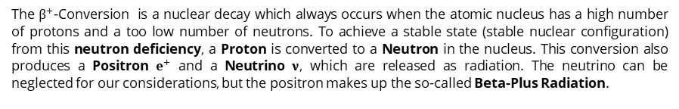




Group II : β⁺- Conversion
Group Puzzle | Nuclear Reactions
Profile : β⁺-Conversion
The $β^{+}$-Conversion is a nuclear decay which always occurs when the atomic nucleus has a high number of protons and a too low number of neutrons. To achieve a stable state (stable nuclear configuration) from this neutron deficiency, a Proton is converted to a Neutron in the nucleus. This conversion also produces a Positron $e^{+}$ and a Neutrino $ν$, which are released as radiation. The neutrino can be neglected for our considerations, but the positron makes up the so-called Beta-Plus Radiation.
Although this has a low penetration power, it is harmful to the human body in high doses. In summary, the following reaction takes place in the core :
$${}_{1}^{1}p→{}_{0}^{1}n+{}_{1}^{0}{e^{+}}+{}_{0}^{0}ν$$
Proton is converted into Neutron, giving off an Positron and Neutrino
For the entire nucleus, this means that a new chemical element is created (since the daughter nuclide has one less proton). The mass number remains the same during the reaction. Besides the $β^{+}$-Conversion, Electron Capture (𝜖) is also possible in case of neutron deficiency. Here, the same daughter nucleus is formed as in the $β^{+}$-Conversion. The only difference is that no positron is emitted, but an electron is absorbed. Electron capture is, so to speak, the alternative conversion channel of the $β^{+}$-Conversion.
$${}_{1}^{1}{p+{}_{1}^{0}{e^{−}}}→{}_{0}^{1}n+{}_{0}^{0}ν$$
Proton is converted into Neutron, with absorption of an electron
$${}_{4}^{7}{Be}$$
$${}_{3}^{7}{Li}$$
$$e^{+}$$
A stable lithium nucleus can be created from a beryllium nuclide with a neutron deficiency with beta-plus conversion
!
In a Nutshell
The overall reaction is
$β^{+}: {}_{Z}^{A}X→{}_{Z−1}^{A}Y+{}_{1}^{0}e+{}_{0}^{0}ν$
$ε: {}_{Z}^{A}X+{}_{−1}^{0}e→{}_{Z−1}^{A}Y+{}_{0}^{0}ν$
Occurs at:
Neutron Deficiency
Radiation released:
Positrons
Expert Task | Stay Positive
Set up the reaction equation of F-18 (Fluorine) and find out which element is produced. Use the nuclide table and the general formula from the Nutshell box.
  The Isotope Potassium-40 (${}_{19}^{40}K$) can transform by both electron capture and beta-plus conversion. Write the two reaction equations of K-40.
Home Group Task
  What to explain:
  Pick any radioactive nuclide that undergoes beta-plus conversion or electron capture from the nuclide table and write down the two reaction equations. Using the equation, briefly summarize beta-plus conversion and electron capture and their properties.
  What you have to find out:
  The Potassium-40 from task b) can undergo one more nuclear conversion. Check it in the nuclide table and note this additional nuclear transformation. Discuss the following question together:
  How can it be that a nuclide can pass into several different daughter nuclei?
Materials created by Hannes Nitsche
Creative Commons Attribution-ShareAlike 4.0 International (CC-BY-SA 4.0)

Slide 3





Group III : Nuclear Fusion
Group Puzzle | Nuclear Reactions
Profile : Nuclear Fusion
Nuclear fusion refers to nuclear reactions in which two atomic nuclei "fuse" to form one or more new nuclides. As we know, nuclear fusion does not take place under natural conditions on Earth (unlike radioactive nuclear conversions such as beta conversion). This is because a physical force "prevents" nuclei from fusing: The two atomic nuclei have positive charges (Protons) and actually repel each other due to the Coulomb force. However, if the ambient temperature and pressure are high enough - that is, if the distance between the nuclides is low and the energy of the nuclides is high enough - the Coulomb barrier can be overcome and fusion can occur. A natural environment in which this is possible is stars. For example, in our Sun, hydrogen nuclei fuse to form helium (The so-called Hydrogen Burning). Examples of possible reactions are
$${}_{1}^{2}H+{}_{1}^{1}H→{}_{2}^{3}{He}+γ$$
Or another example:
$${}_{2}^{3}{He}+{}_{2}^{3}{He}→{}_{2}^{4}{He}+{}_{1}^{1}H+{}_{1}^{1}H$$
In fusion reactions, there are always two atomic nuclei on the left side of the equation. On the right side there is at least one daughter nucleus. A wide variety of other particles can be released, such as here a gamma quantum (Photon, denoted by $γ$). Often the daughter nucleus is also radioactive can undergo further nuclear conversions.
$${}_{2}^{4}{He}$$
$${}_{4}^{8}{Be}$$
$${}_{2}^{4}{He}$$
$$γ$$
An important nuclear fusion in stars is the fusion of two helium-4 nuclei. Here a beryllium nucleus is formed and gamma radiation is released.
!
In A Nutshell
The overall reaction is generally
${}_{Z_{1}}^{A_{1}}{X_{1}}+{}_{Z_{2}}^{A_{2}}{X_{2}}→{}_{Z_{3}}^{A_{3}}Y+$ …
Occurs at:
High Temperatures & Pressure
Radiation released:
different
Expert Task | Fusion in the Laboratory
  In 1917, Ernest Rutherford succeeded in performing a fusion reaction in the laboratory. He irradiated a gas of Nitrogen ${}_{7}^{12}N$mit accelerated Helium Nuclei ${}_{2}^{4}{He}$. The reaction produced a daughter nucleus and a single proton ${}_{1}^{1}p$.
Write the reaction equation. Use the conservation of mass number and proton number and the nuclide table to find the daughter nucleus (the formula in the Nutshell box can help you).
  Make conjectures to answer the following question:
  Although this fusion reaction was observed as early as 1917 and today a wide variety
  of nuclear fusions can be carried out with the help of particle accelerators, it is not yet
  possible to use nuclear fusion as an effective energy source. How can this be?
Home Group Task
  What to explain:
  Write down the reaction equation of the fusion of two helium-4 nuclei (there is only one daughter nuclide and a photon released). Using the equation, briefly summarize nuclear fusion and its properties.
  What you have to find out:
  The resulting isotope of the Rutherford reaction from task a) is radioactive. Use the nuclide map to set up the subsequent Conversion equation with the help of Group 1.
Materials created by Hannes Nitsche
Creative Commons Attribution-ShareAlike 4.0 International (CC-BY-SA 4.0)

Slide 4





Group IV: Neutron Capture
Group Puzzle | Nuclear Reactions
Profile : Neutron Capture
Nuclear reactions are physical processes in which two nuclides (atomic nuclei) react or fuse with each other. One nuclear reaction of particular importance in nuclear astrophysics is neutron capture. Here, one of the two reactants is a Neutron. An example of neutron capture is the following reaction with natural gold (Au-197):
$${}_{79}^{197}{Au}+{}_{0}^{1}n→{}_{79}^{198}{Au}+γ$$
The nuclide Au-197 absorbs a neutron, creating a new isotope. This isotope Au-198 is in a highly excited state, and emits its excess energy in the form of a gamma quantum (= photon, $γ$). Nuclear reactions usually require energy to be added to make the reaction possible. However, unlike other nuclear reactions, neutron capture is possible at very low kinetic energies of the neutron. One can also calculate the released energy ∆𝐸 in a nuclear fusion like neutron capture:
$$Rest Energy Parent Nuclide+Energy Neutron=Rest Energy Daughter Nuclide+released Energy$$
Or as formula:
$$E_{0}\left(X\right)+E\left(n\right)=E_{0}\left(Y\right)+∆E$$
$${}_{2}^{3}{He}$$
$${}_{2}^{4}{He}$$
$${}_{0}^{1}n$$
Helium-3 is stable, but can react with a free neutron to produce Helium-4, which has a higher binding energy.
!
In a Nutshell
The overall reaction is generally
${}_{Z}^{A}X+{}_{0}^{1}n→{}_{Z}^{A+1}Y+γ$
Occurs at:
Free Neutrons
Radiation released: Photons
Expert Task | Nuclear Waste
  A significant proportion of nuclear waste from nuclear reactors is produced by neutron capture in nuclear reactors. In this process, the original nuclear fuel (usually Uranium) reacts with free neutrons to produce radioactive isotopes with even higher mass numbers. An example of this is neutron capture with U-238 (Uranium isotope, which even occurs naturally in small quantities).
Set up the reaction equation and use conservation of mass number and proton number and the nuclide table to determine the daughter nucleus (The formula in the Nutshell box can help you).
  Calculate the energy released $∆E\text{.}$ $\text{Use} \text{the} \text{following} \text{values}$:
  $E_{0}($U-238$)=221,70 GeV$ $E_{0}($U-239$)=222,63 GeV$ $E\left(n\right)=1,16 GeV$
Home Group Task
  What to explain:
  Choose any stable nuclide and write down the reaction equation for neutron capture. Using the equation, briefly summarize neutron capture and its properties.
  Explain how to calculate the energy released in a fusion reaction.
  What you have to find out:
  Why can neutron capture occur at particularly low kinetic energies? Ask group 3 and find out what the "Problem" is in nuclear fusion and what the Coulomb barrier is.
Materials created by Hannes Nitsche
Creative Commons Attribution-ShareAlike 4.0 International (CC-BY-SA 4.0)

Slide 5
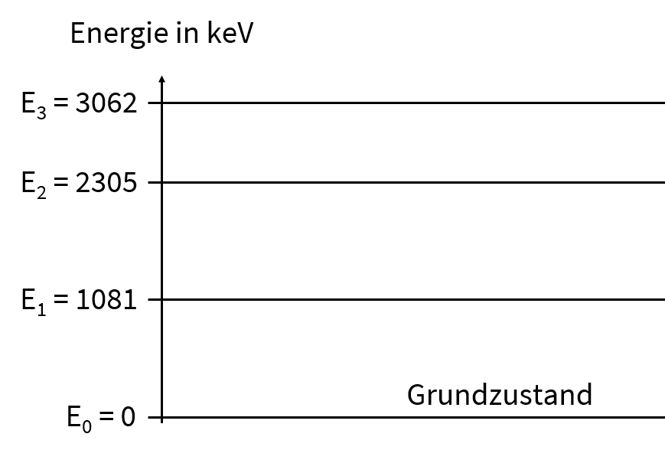
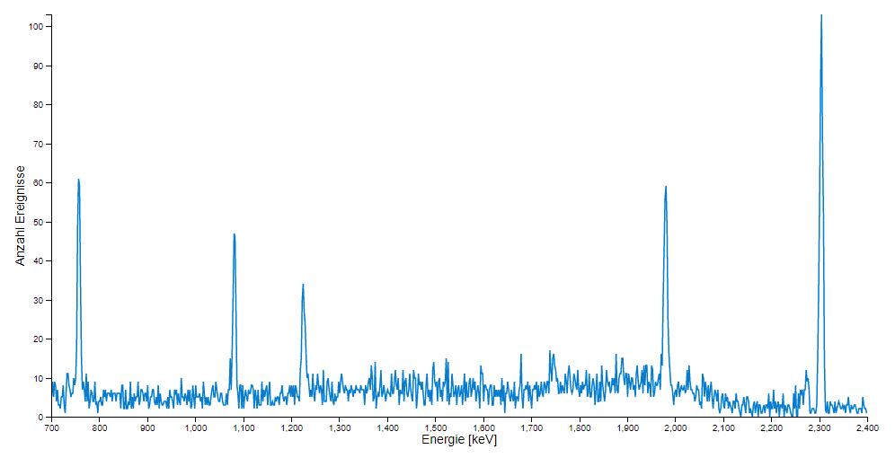
^{01 How to Catch a Photon}
Data Analysis of the ¹⁴N(α,γ)¹⁸F – Reaction
Task 1 | The Energy of a Photon
  A resting N-14 nuclide reacts with a He-4 nuclide with a kinetic energy of $E_{kin}=2 MeV$. Nuclear fusion is initiated, producing only one daughter nuclide. Note the reaction equation and determine the reaction products.
  During the reaction, a gamma quantum (photon) with a kinetic energy is released. Calculate the kinetic energy of the photon using the conservation of energy and the rest energies of the reactants involved (see nuclide map). For the rest energy applies:
  $E_{0}=m_{A}∙931,49 MeV/u$
$m_{A}$ … Atomic mass in u ,
$m_{A}$ is indicated in nuclide map
  What assumptions did you have to make to calculate the photon energy in 1b? Is the calculated energy the only possible kinetic energy the photon can have?
Task 2 | Energy Levels
Energy in keV
  Figure 1 shows 4 possible energy levels of an atomic nucleus. During the transition from excited states to the ground state, photons are released whose energy is measured by a detector. The experiment is repeated several times and an energy spectrum is recorded (see Fig. 2, large on the board).
  Some photon energies are measured conspicuously often (so-called Peaks). How do the energies of the peaks relate to the energy level diagram in figure 1? Explain. Formulate the relationship with the help of equations.
  Fig.1: Term Diagram
  Go back to question 1c. Do you still agree with your conjecture? Correct your guess if necessary.
  Fig.2: Related energy spectrum
Materials created by Hannes Nitsche
Creative Commons Attribution-ShareAlike 4.0 International (CC-BY-SA 4.0)

Slide 6
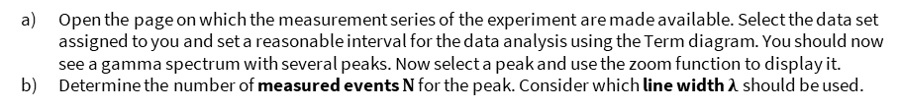
^{02 Measurement and Analysis}
Data Analysis of the ¹⁴N(α,γ)¹⁸F – Reaction
Task 3 | Analyzing the Spectrum
  Open the page on which the measurement series of the experiment are made available. Select the data set assigned to you and set a reasonable interval for the data analysis using the Term diagram. You should now see a gamma spectrum with several peaks. Now select a peak and use the zoom function to display it.
  Determine the number of measured events 𝐍 for the peak. Consider which line width $λ$should be used.
$$λ= \\ N\left( ________keV\right)=$$
  Determine the number of measured events 𝐍 for the other energy transitions. Subtract the background according to the scheme shown. Enter your measurement results in the common measurement table.
Task 4 | Cross Section
  The cross section 𝝈 of the reaction can now be calculated from the count rate N for the transitions. Use the following formula to calculate the cross section for your energy transitions. Also calculate the total cross section $σ_{T}$for your run (sum of the cross sections of all peaks considered).
$$σ=\frac{N}{N_{P}∙p∙d}=\frac{Count Rate}{Number Projectiles∙Detection Probability∙Target Density}$$
Task 5 | The Thermonuclear Reaction Rate
  The thermonuclear reaction rate of the reaction observed here can now be determined from the total cross section $σ_{T}$. It is strongly temperature dependent. If we assume that the reaction takes place inside red giants, a temperature of 1 GK can be assumed. As an approximation, the thermonuclear reaction rate for the reaction of N-14 with He-4 is as follows:
$r_{Th}\left(T=10^{9}K\right)=12889,6∙{\left(\frac{m_{1}+m_{2}}{m_{1}m_{2}}\right)}^{\frac{3}{2}}∙σ_{T}∙10^{24}\frac{1}{cm^{2}}$ $\left[r_{Th}\right]=\frac{cm^{3}}{mol∙s}$
$m_{i}$ .. Atomic Mass in u
$σ_{T}$ … Total Cross Section
Calculate the thermonuclear reaction Rate of the ¹⁴N(α,γ) reaction.
Materials created by Hannes Nitsche
Creative Commons Attribution-ShareAlike 4.0 International (CC-BY-SA 4.0)

Slide 7
Nuclide Race: Rules
Formation of Heavy Elements
Aim of the Game
The task is to synthesize the target nuclide with the help of neutron capture, that is, to reach it with your game figure. Try to reach the goal in fewer steps than your opponent.
Game Rules
To advance nucleosynthesis, you must try to climb to the top right of the nuclide table. The neutron capture helps you to do this. However, neutron capture takes place only with a certain probability. Unstable nuclides can also decay before neutron capture occurs.
Both players start their first turn at the same time and have to follow the following procedure :
Calculate the probability ratio for the nuclide you are standing on (indicates how likely neutron capture is compared to the decay of the nuclide).
Take from the table which number each of you must roll for a neutron capture to succeed. The higher the probability ratio, the higher your chance of neutron capture.
Each of you now rolls the dice in turn to attempt a neutron capture.
There are two possibilities:
  If your dice count is high enough, you can make the neutron capture move on the board and continue playing. Your turn continues, so you start again with step 1 on the new field.
  If your dice number is too low, the nuclide you are standing on will decay. So you have to move your piece according to the rules of nuclear decay:
  Beta-Minus, Double Beta-Minus, Beta-Plus, or Double Electron capture.
  With this, your turn ends. Your opponent may continue until he also has to make a nuclear decay. Only when you have both made a nuclear decay, you may re-enter the race.
The player who gets to the given goal in fewer moves wins the nuclide race. After each game, compare the paths you both took.
Probability Ratio $p_{n}/λ$ | Required number for a Neutron capture
< 0,0001 | Neutron Capture not possible
0,0001 – 0,009 | 6
0,001 - 0,09 | 5 or 6
0,1 - 99 | 4,5 or 6
100 – 9 999 | 3, 4, 5 or 6
10 000 – 100 000 | 2,3,4,5 or 6
> 100 000 or stable | 1,2,3,4,5 or 6
Materials created by Hannes Nitsche
Creative Commons Attribution-ShareAlike 4.0 International (CC-BY-SA 4.0)

